Slide 1



Follow-up of Wide-Field Transient Surveys
Mark Sullivan
(University of Oxford)

Slide 2
Wide-field transient surveys
New era in optical survey astronomy
1–2m-class telescopes equipped with dedicated wide-field imagers, surveying thousands of sq. degrees with time domain information
No census of optical “transients” in the local universe
  (Existing surveys monitor big, bright galaxies with irregular cadences)
New explosion types, new physics: events important at high redshift
Demographics of known SN types
Type Ia Supernova cosmology and Dark Energy
Variable stars, active galaxies, etc.
Transient follow-up will become very important:
  Currently ~10% of 4m-class telescopes; pressure will increase
  Optical: PS1, PTF, SkyMapper, QUEST, GAIA, DES, LSST
  Radio: LOFAR, SKA

Slide 3
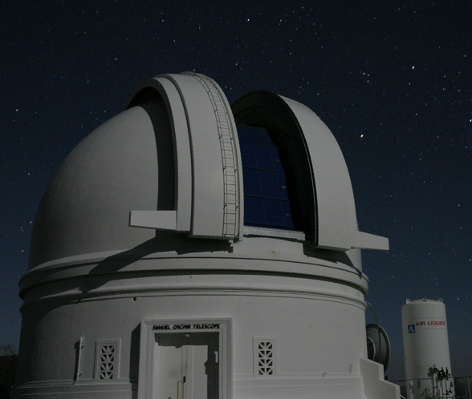
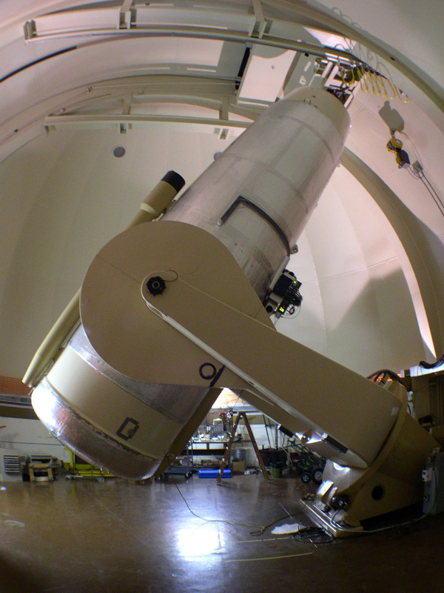
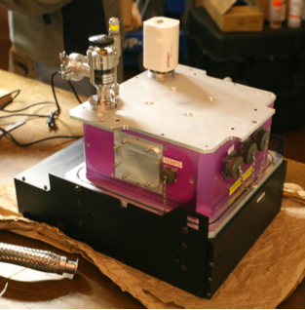
PTF: Palomar 48in (1.2m) + CFH12k camera
Wide-angle, variable cadence (1m-5d) sky survey in g and r
Looking for supernovae, novae, CVs, planets
Survey commenced June 2009
A goal of “real-time” transient detection
Type Ia Supernova program led by Oxford (+LBNL)

Slide 4
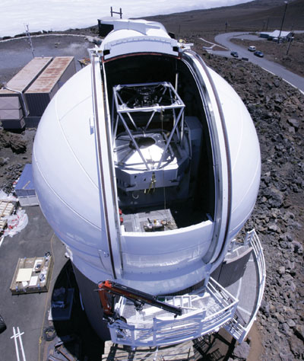
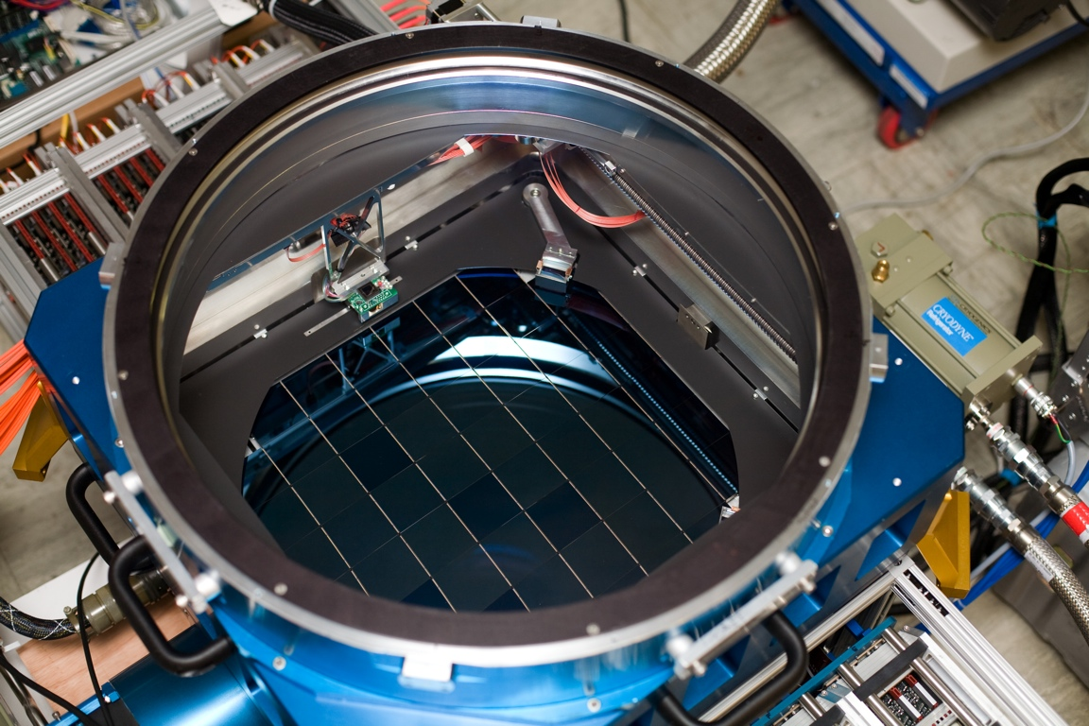
PanSTARRS1
1.8m + 1.4 Gigapixel Camera
7 square deg FOV
Image Processing Pipeline (IPP)
Few Tb of data every night
Core-collapse project led by QUB
Notes:
* Also the IPP : data reduction & analysis
- generate wrapped, stacked and difference images
- also scan these images produce catalogues of detected sources

Slide 5
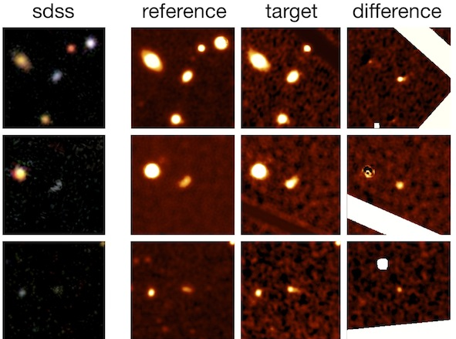
Current status
PTF is fully operational
One transient found every 20 minutes
PS1 science operations since February 2009
122 good SN candidates identified (as of 19th March)
About 30 spectroscopically classified
Spectroscopic transient type | #
SN Ia | 193
SN II | 53
SN Ibc | 7
Unknown SN | 25
Novae | 3
CV | 30
Other variable stars | 11
“Rather weird” | 3
Both surveys require extensive follow-up, particularly spectroscopy, to extract any science

Slide 6
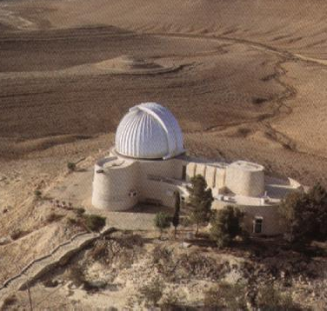
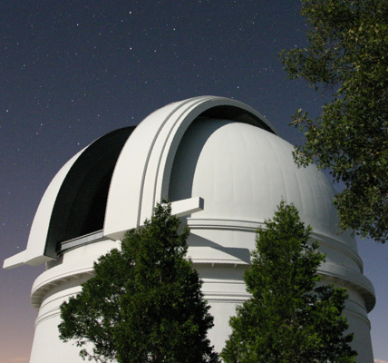
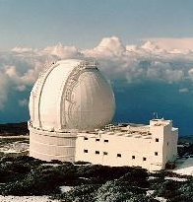
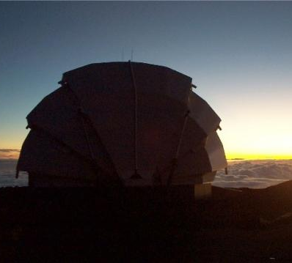
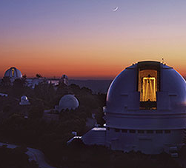
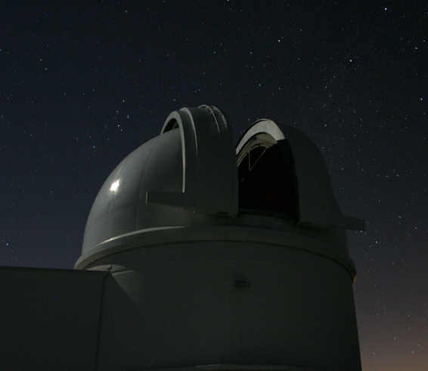
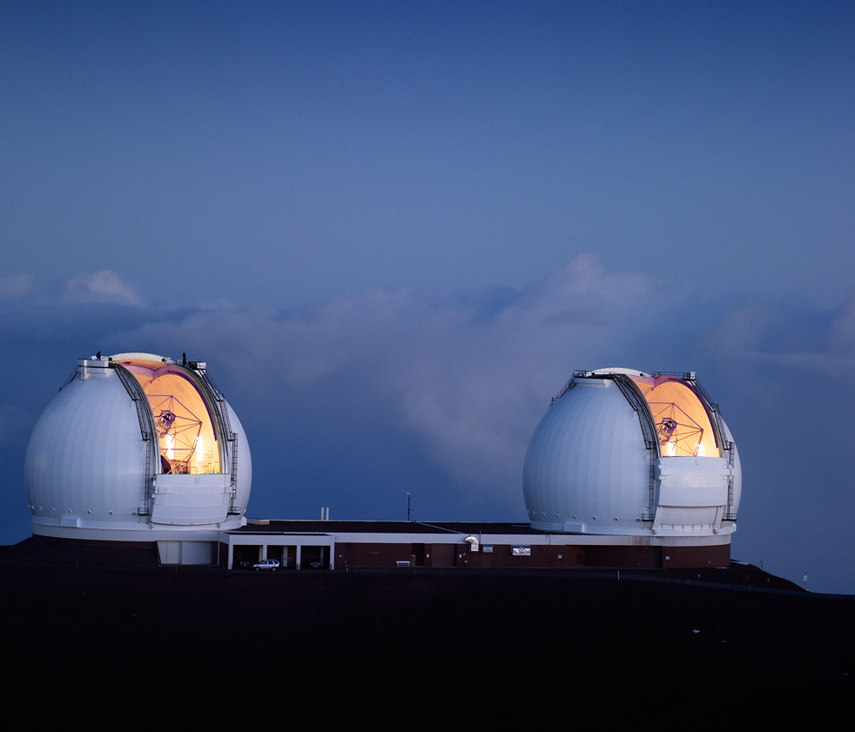
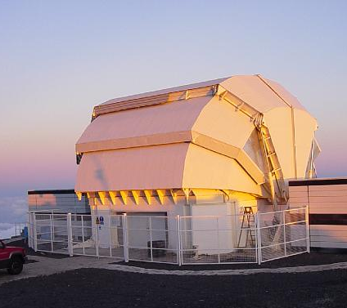
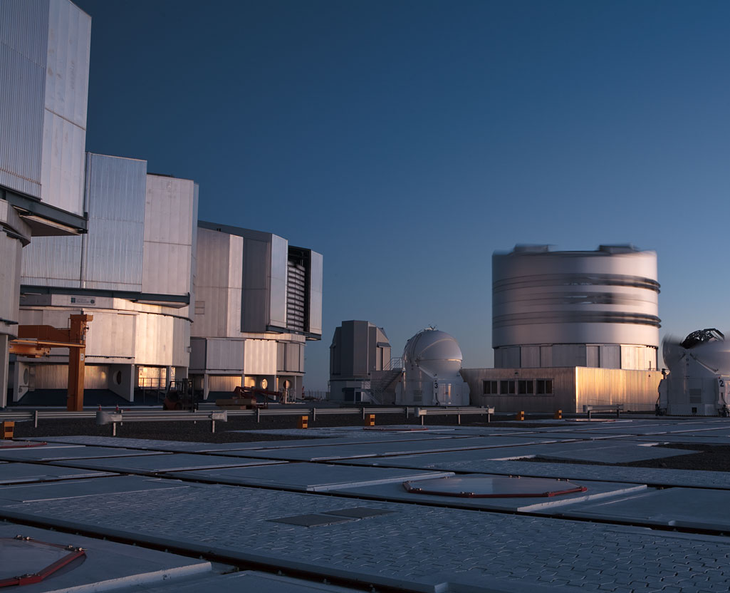
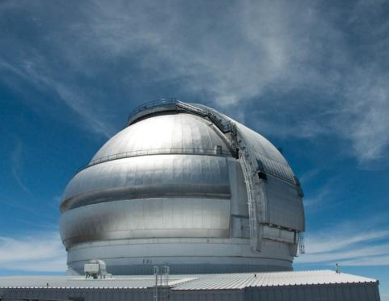
Follow-up is the key
Photometry
Spectroscopy
Large programmes on many facilities, including substantial UK involvement
4m-class telescopes are the work-horse facilities doing the bulk of the identification and follow-up work
PTF and PS1 UK groups have joined forces for large WHT programme
Wise
P200
WHT
Faulkes
Lick
P60
Keck
ESO
Gemini
LT

Slide 7
Current WHT Programme (PTF+PS1)
Good example of how transient follow-up is currently done
Classically scheduled as 6n 09B, 10n 10A; 2n/month
ISIS (some ACAM)
Observe ~30 targets a night
  Two surveys means it is very unlikely there are no targets to follow
Used for:
  Spectroscopic confirmation (50%)
  Monitoring of previously confirmed targets (50%)
Time is in conjunction with:
  4m time provided by other collaboration members (Lick, P200, …)
  A very few ToOs on queue-scheduled 8m’s
WHT time is a major contributor to both PTF & PS1 follow-up

Slide 8
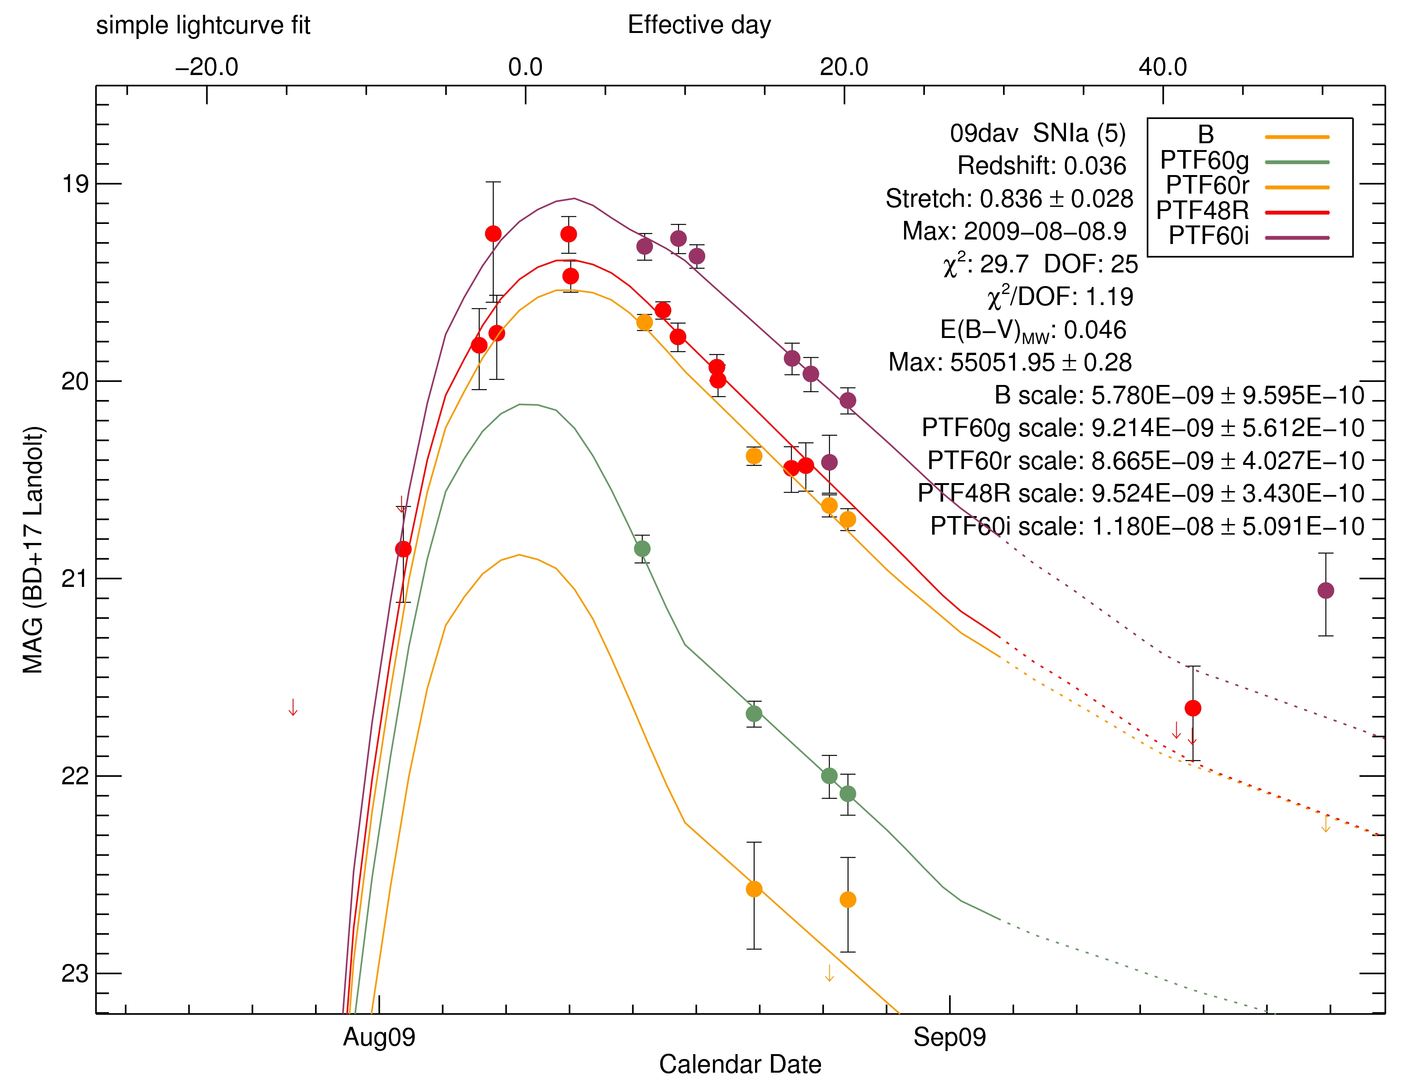
New explosion types: PTF09dav – a mystery
Confirmed with WHT Aug 09
40kpc from putative host
Faint – M_{B}=-15.6
Fast – 1 mag in 10 days (required rapid follow-up)
Similar to 1991bg but with He and H in nebular phase

Slide 9
New explosion types: “Super-duper”novae
3 peculiar SNe Ic found in PTF
Low-luminosity hosts; low metallicity
Reach -23 absolute – nearly 50 times brighter than a SN Ia
Very slow 50d rise to maximum; UV bright

Slide 10
Spectra
(again, from WHT)
No H or He
Broad UV features match to CII (2200A) and Mg II (2700A), with some Si III
No good physical mechanism. Possibly pair instability SNe?

Slide 11
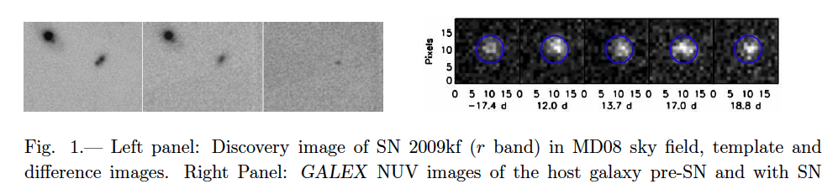
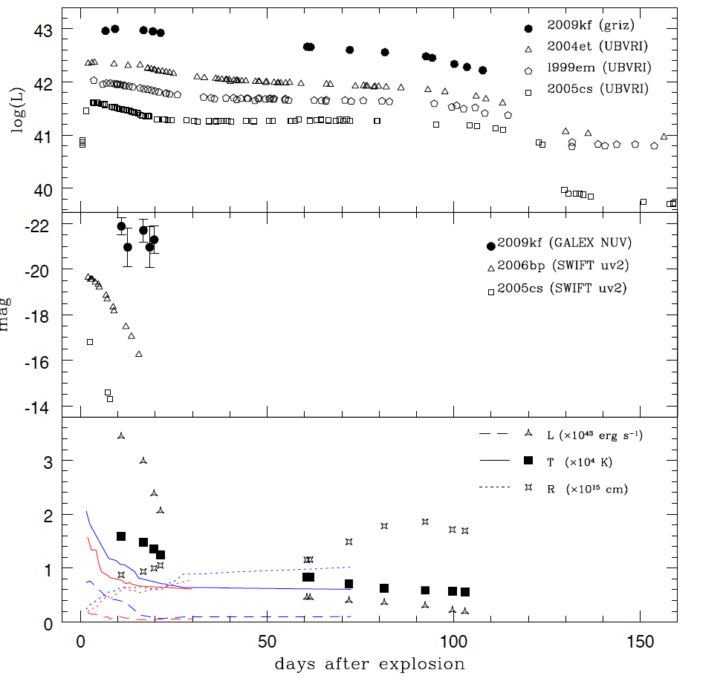
SN2009kf : a UV bright type II
Botticella et al. 2010, ApJL, submitted
Joint PS1-GALEX discovery
GALEX is observing PS1 fields on same cadence
Extremely luminous in the UV
Much brighter (and hence hotter) than other II-P SNe at this epoch
Very luminous plateau magnitudes
Bright II-P useful as cosmological candles
If M_{UV}~ -22, then these SNe could be visible at z ~ 2 in the stacked PS1 medium deep data (e.g. Cooke et al. high-z SNe)

Slide 12
Future WHT for transient follow-up?
With 1 transient discovered every 20m, regular observations are required
Classically scheduled time is good but:
  Several nights a month on 4m telescopes
  Follow-up dependent on several telescopes (therefore several TACs…)
  Demanding in terms of resources for observing teams
Different modes of operation?
  Ideally, transient follow-up needs time spread across the entire month
    (Opens up new discovery space; rapid follow-up; regular monitoring)
  ToO? But would require lots and not ToO in the true sense
  Queue mode? Works well at ESO/Gemini; expensive for observatory
  Flexible scheduling as at UKIRT?
  Remote observing for some science?
  Robotic operation (prob. not feasible at WHT?)

Slide 13
New Instrumentation?
IFU spectrograph could be simple for remote or flexi-queue:
  Precise acquisition is easier (reduces pressure on observer)
  Observing can be very automated and low overhead
  Provides excellent flux calibration; no slit loss (great for SNe)
  Information on environment of transient
  New mode on existing instrument?
SNIFS (on UH2.2m) example:
  6”x6” FoV; 225 samples via microlens array
  Blue arm for <5500A, red for >5500A
  2kx2k CCD; 0.34” pixels
  Operated completely remotely (often from France)
  Very efficient way of doing transient follow-up

Slide 14
Summary
Surveys for transients are changing astronomy; this will continue
New science impacts on many disparate areas of astrophysics
4m telescopes, like WHT, are the best facilities to confirm their nature and study them in detail
They require largish amounts of spectroscopic time
  Classical observing is not ideal
Flexible scheduling (with remote observing?) a good alternative
IFU spectroscopy would be very efficient

Slide 15
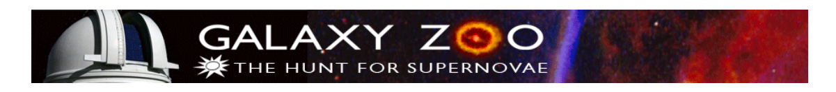
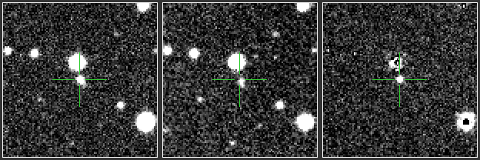
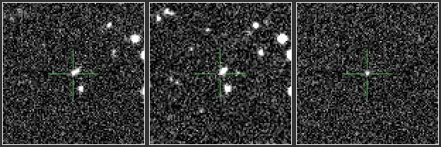
Surveys generate thousands of transient candidates
Searching through them efficiently is demanding
Use the public to identify the best objects
–
=
–
=
Guided by decision tree
Candidates must be clean, have positive pixels, not be elongated or diffuse, etc.

Slide 16
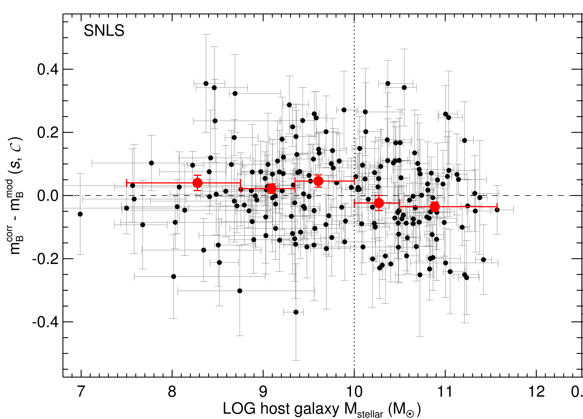
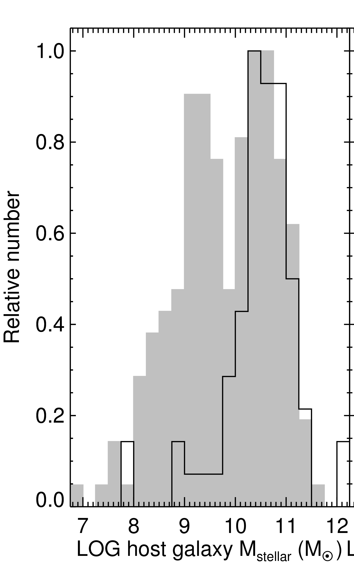
SN cosmology – SN brightness depends on host
SNe Ia are brighter (4σ) in massive galaxies after lightcurve shape and colour correction
Existing low-redshift surveys heavily biased towards massive galaxies
Need to replace existing low-redshift samples

Slide 17
Supernova zoo homepage

Slide 18
Trial in October 2009
Used a WHT run to trial Galaxy Zoo: Supernova
2000 people visited over 2 days, contributing 100,000 classification clicks (35,000 events)
Public is very good at supernova classification
Blogs and forums keep users up to date with real-time observations
Site is not PTF-specific and will work with any survey
Resources and infrastructure exist and work

