Slide 1
Clusters of galaxies
With a wide-field multi-IFU spectrograph

Slide 2
Cluster studies
Clusters provide large samples of galaxies in a moderate field
Unique perspective on the interaction of galaxies with their environment
As they operate much as a closed box, they are useful as tracers of galaxy evolution and of cosmology

Slide 3
Premise
We will propose a multi-IFU instrument useful for the study of galaxies in clusters

Slide 4
Key design requirement parameters
Field of View
Spectral resolution
Wavelength coverage
Efficiency or throughput
Crowding restrictions (fibre bundle collisions)
Number of IFUs
Number of elements per IFU
Reconfiguration time

Slide 5
Competitors/references
Keck/DEIMOS; Keck/LRIS (multislits)
VLT/KMOS (infra-red)
MMT/Hectospec (single fibre)
AAT/AAOmega (single fibre)
VLT/Giraffe
  15 IFU + 15 sky
  Each IFU is only 20 elements, 3x2 arcsec, 0.5 arcsec pixels.

Slide 6
Cluster sizes
Redshift z = 0.003 (Virgo) to 1.4, WHT will operate at the low end of this.
Core radius ~1.5º for Virgo, ~7 arcmin for Coma, to a few arcseconds.
Virial radius (normally taken as the radius at which the density is 200 x ambient) is ~2 Mpc for rich clusters (1.2º at Coma)
1.5 degree diameter field would match virial radius at z~0.035.

Slide 7
Cluster types
Classified by:
  Richness
  Concentration
  Dominance of central galaxy (Bautz-Morgan)
  Morphology (Rood-Sastry) – cD, B, L, C, I, F
  Galaxy Content (elliptical rich, spiral rich etc)
  X-ray structure
Clusters present a wide range of environments

Slide 8
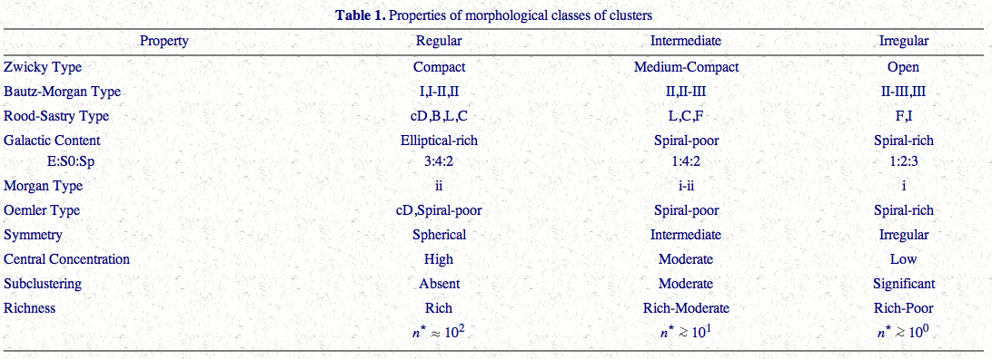
Cluster Types
From Craig Sarazin

Slide 9
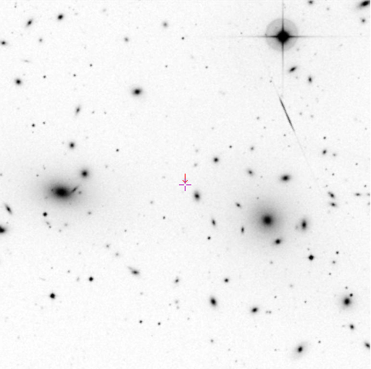
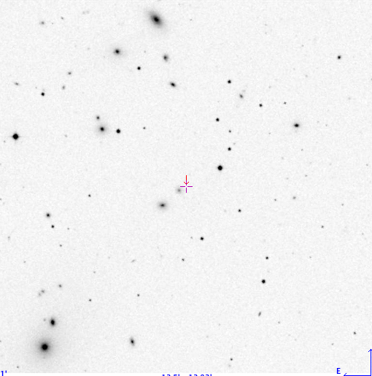
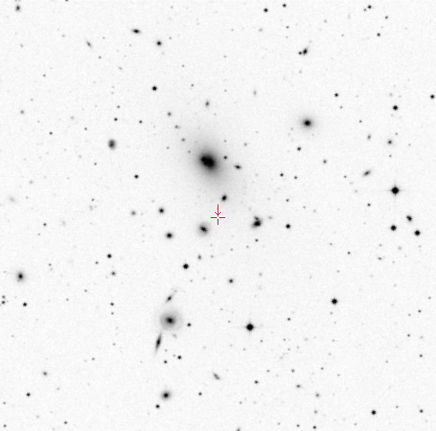
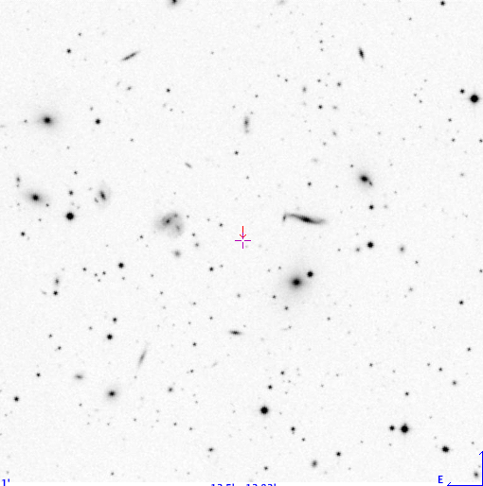
A1656 – BM II
A1367 – BM II-III
A2199 – BM I
A2151 – BM III

Slide 10
What do we want to know
Mass profiles
Galaxy properties
  Luminosity function
  Stellar content
Evolution with redshift of these properties
Effect of environment upon galaxy:
  Morphology
  Current star formation
  Dynamical state (e.g. tidal truncation)

Slide 11
Cluster evolution
Necessity of low redshift samples in clusters of all types.
Easy to get 8-10 m time for high-redshift clusters, but not for the vital low-redshift comparisons.
WHT is best employed making sure we understand the low-redshift population.

Slide 12
Science measurements
Absorption lines
  Spatially resolved kinematics
    Velocity (for membership),Velocity dispersions, Fundamental Plane
  Line strengths
    Ages, metallicity, epoch of last star formation, ”Z-planes”
Emission lines
  Spatially resolved kinematics
    Tully-Fisher relation
    Ram pressure or tidally induced star formation
  Fluxes or equivalent widths
    Metallicity in galaxies and intra-cluster gas

Slide 13
Examples:
Examples from recent work
How can WHT contribute when there are larger telescopes around?
What are the requirements?

Slide 14
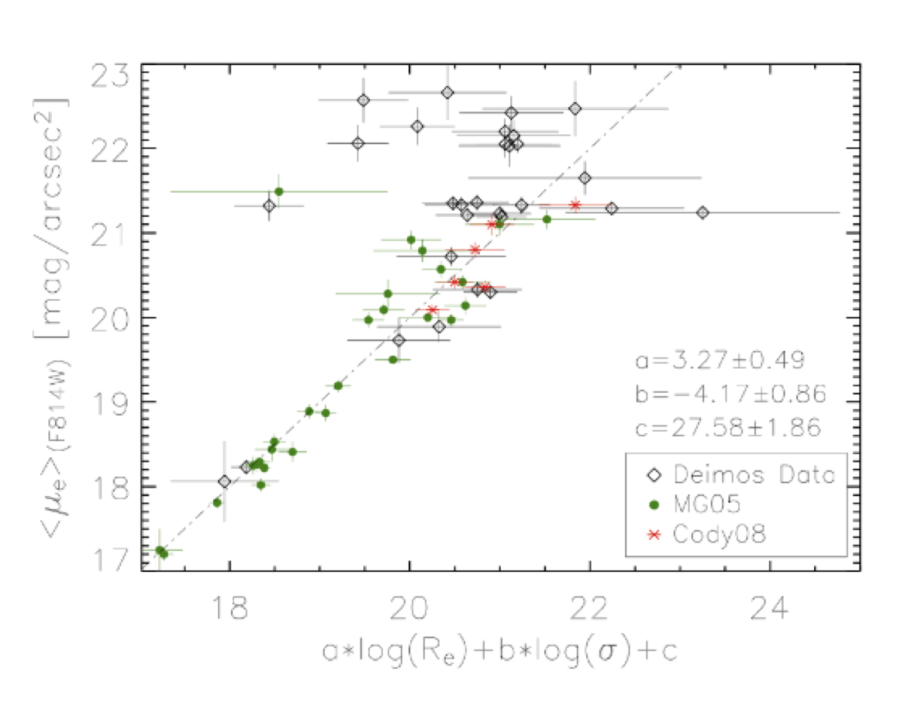
Example – Fundamental plane and Faber-Jackson relation of dwarfs
Ehsan Kourkchi et al. – Keck/DEIMOS data

Slide 15
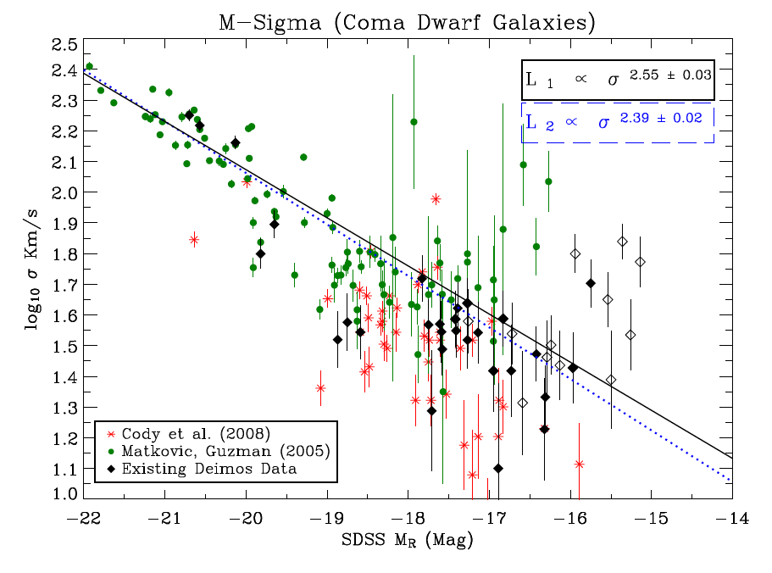
Example – Fundamental plane and Faber-Jackson relation of dwarfs
Ehsan Kourkchi et al. – Keck/DEIMOS data

Slide 16
Requirements for FP/FJ relation
σ down to 20 km/s requires R ~ 5000 - 7000
λrange 820 – 870 nm and/or 480 – 570 nm
Control over aperture corrections
IFU aperture ~ 10 arcsec for comparison with Keck etc. observations of clusters at Z ~ 0.5 - 0.8
Samples of tens of galaxies (not hundreds)
Exposures of hours

Slide 17
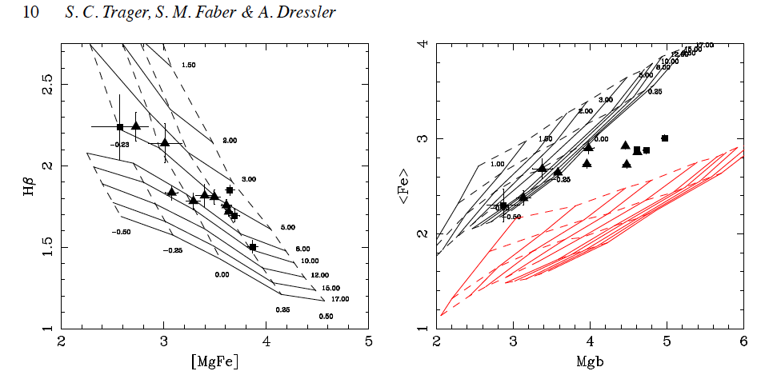
Stellar populations
Estimate 3 parameters: weighted age; [Z/H]; [α/Fe] (or [E/Fe]) by fitting line pairs of index measurements onto model grids.
[α/Fe] tells you something about the timescale of star formation.
Keck/LRIS data
Scaled Solar
[E/Fe] = +0.3

Slide 18
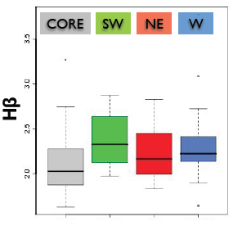
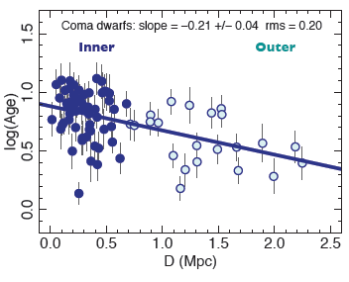
Example – Star formation ceased more recently in the outer parts of Coma
Russell Smith et al. using MMT/ Hectospec

Slide 19
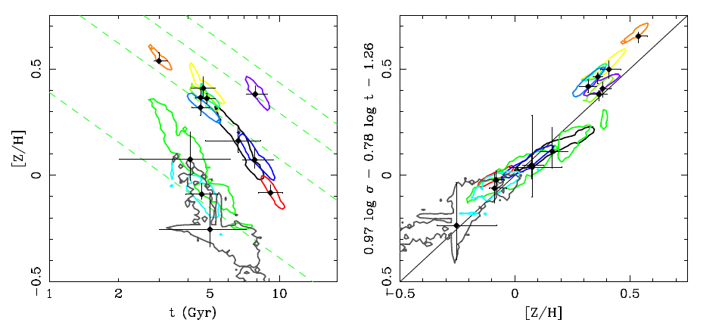
Z-planes
4 dimensional space (age, [Z/H], [α/Fe], σ)
Marginalise over one parameter and then you have something which looks a bit like the FP.

Slide 20
Requirements for stellar populations
R ~ 1000
λ range 390 – 600 nm (820 – 870 nm also useful but not vital)
Field of view ~ 1 degree or more.
Aperture ~ 10 arcsec if we are comparing with distant clusters
Samples of tens to hundreds of galaxies.

Slide 21
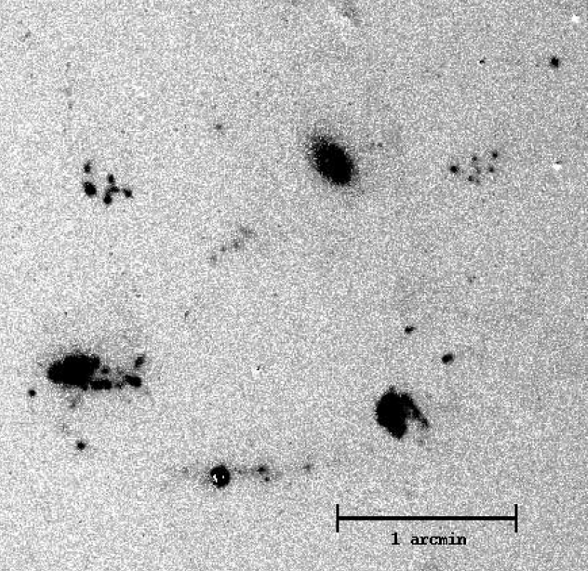
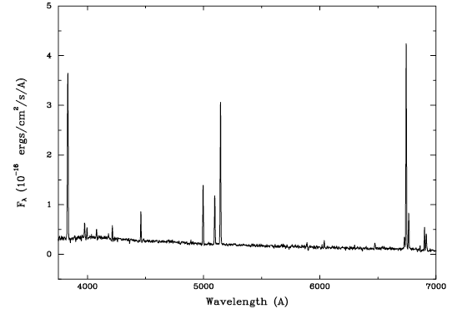
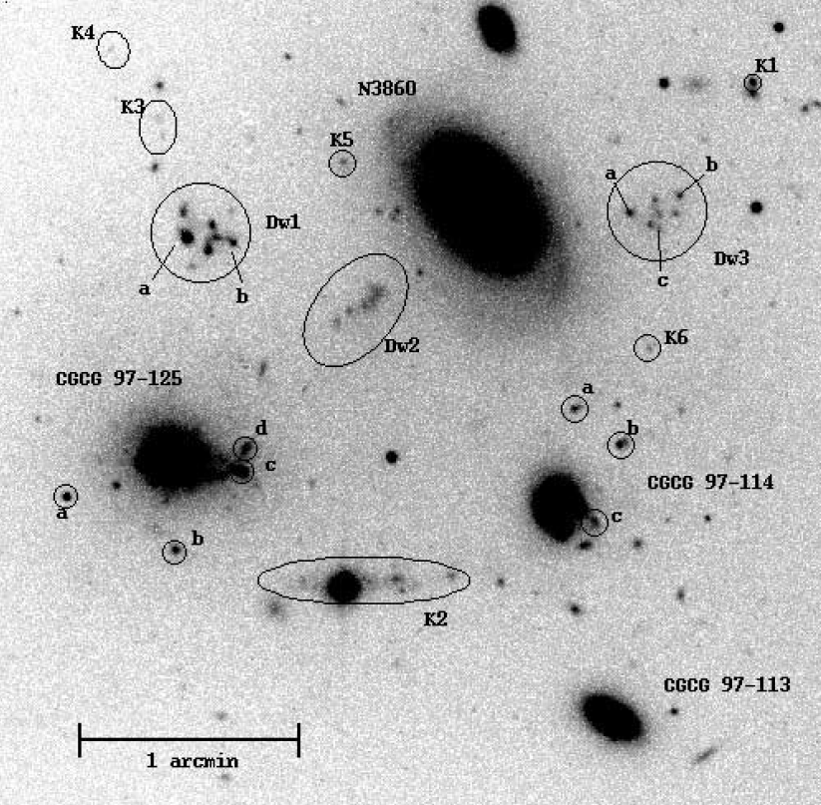
Example – tidal or ram-pressure induced starbursts
Hα images
Sakai et al. in Abell 1367
Anomalously metal rich starbursts?

Slide 22
Requirements for emission line diagnostics
R ~ 1000 – 2000
λrange 370 – 700 nm
Field size ~ virial radius
Aperture 10 - 30 arcsec
Samples of a few

Slide 23
Distant clusters (z ~ 0.3 – 0.5)
Postman et al. HST/MCT allocation
  524 orbits with ACS and WFC3
  24 clusters z ~ 0.15 – 0.9, in 14 passbands
  Headline science is gravitational lensing and supernovae, however far more interesting will be the multiband dataset on the cluster targets themselves.
  Spectroscopic followup of samples selected on colours and morphology.

Slide 24
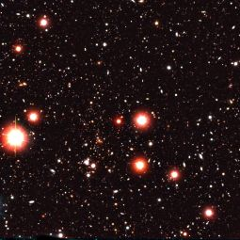
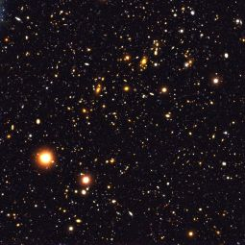
Distant clusters (z ~ 0.3 – 0.5)
EDisCS
  ESO Distant Cluster Survey
  Identification, deep photometry and spectroscopy of 10 clusters around z ~ 0.5 and 10 around z ~ 0.8
  Spectroscopy is FORS2 (R ~ 1200)
  Science goals are build up of stellar populations with redshift (plus weak lensing).

Slide 25
However:
In general spectroscopic followup will use larger (8-10m) telescopes.
Better with single fibres, with more attention paid to how close you could position them to each other.
Alternative is large single IFU covering whole cluster core
Moves required spectral coverage for same science goals redwards.

Slide 26
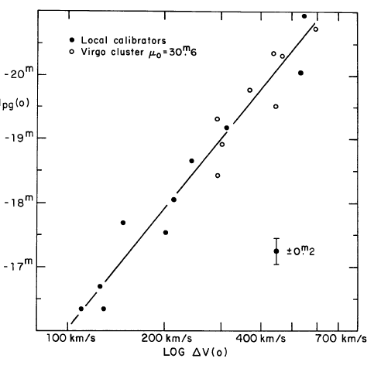
Example – Evolution of the Tully-Fisher relation
Originally a distance indicator, now a tool for measuring evolution of galaxy luminosity
Correlation between V_{max} and absolute magnitude
Originally V_{max} from HI single beam measurements
Optical V_{max} measured with Hαline
Aperture has to be large enough

Slide 27
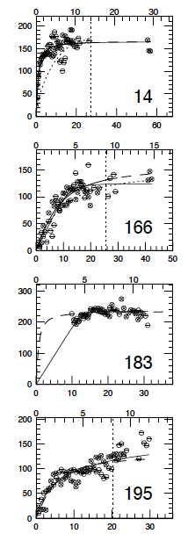
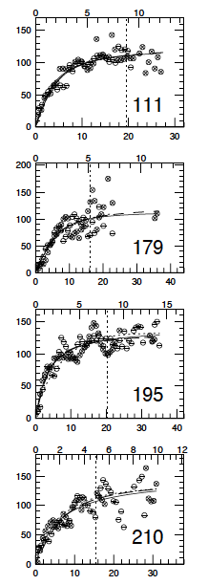
Optical Tully-Fisher relation
From Stéphane Courteau
Require to get out to 10 – 20 kpc
Top horizontal axis is in kpc

Slide 28
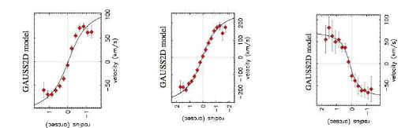
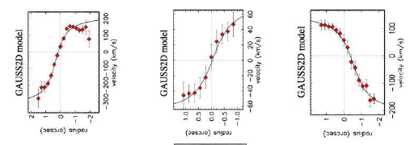
Tully-Fisher relation at z ~ 0.3 – 0.5
Metevier et al. in Cl0024 at z ~ 0.4. Keck/LRIS data
Find galaxies underluminous with respect to local T-F relation

Slide 29
Requirements for T-F evolution
Aperture must be 20 – 40 kpc diameter, equal to 4.8 – 9.6 arcsec at z = 0.2.
R ~ 1000
λrange 780 – 990 nm (Hα at z = 0.2 - 0.5)
Field size 5 - 15 arcminutes
Samples of 10 - 30

Slide 30
Key design requirement parameters
Field of View 1.5º; 1º minimum
Spectral resolution R = 1000 - 7000
Wavelength coverage λ= 370 – 990 nm
Crowding restrictions (fibre bundle collisions) 2-3 x aperture size
Number of IFUs Minimum 30
Number of elements per IFU 100 (10 x 10 arcsec)
Reconfiguration time not critical

