Slide 1
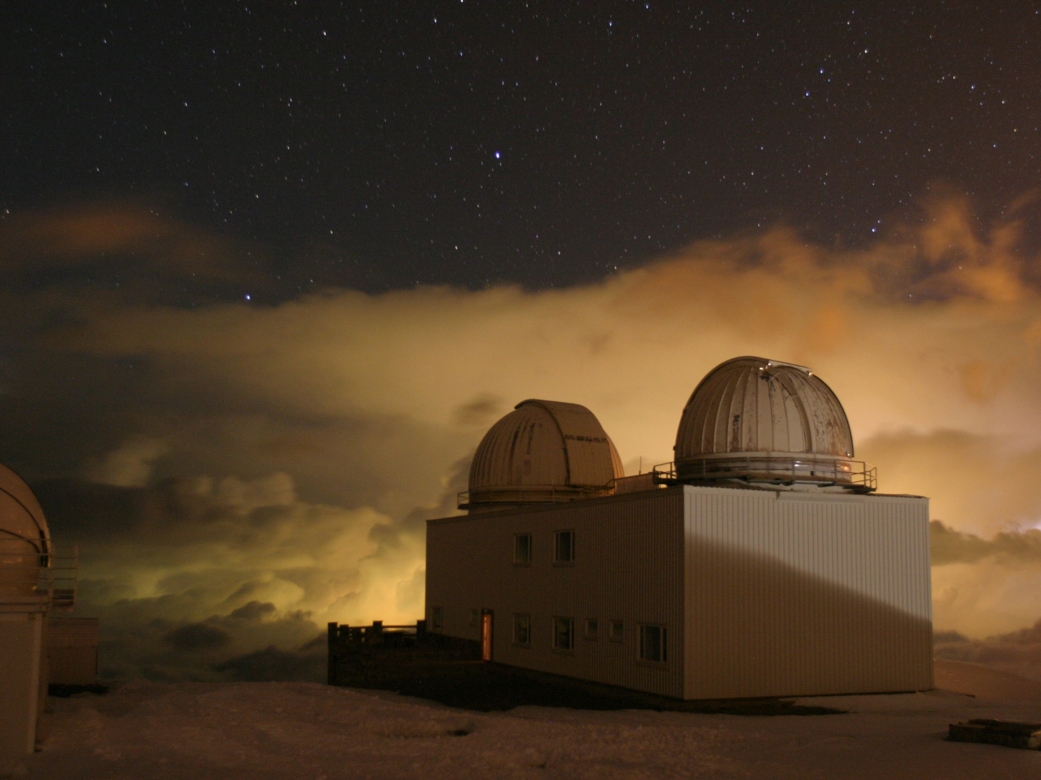
Observatorio de Sierra Nevada
Susana Martín Ruiz (IAA-CSIC)

Slide 2
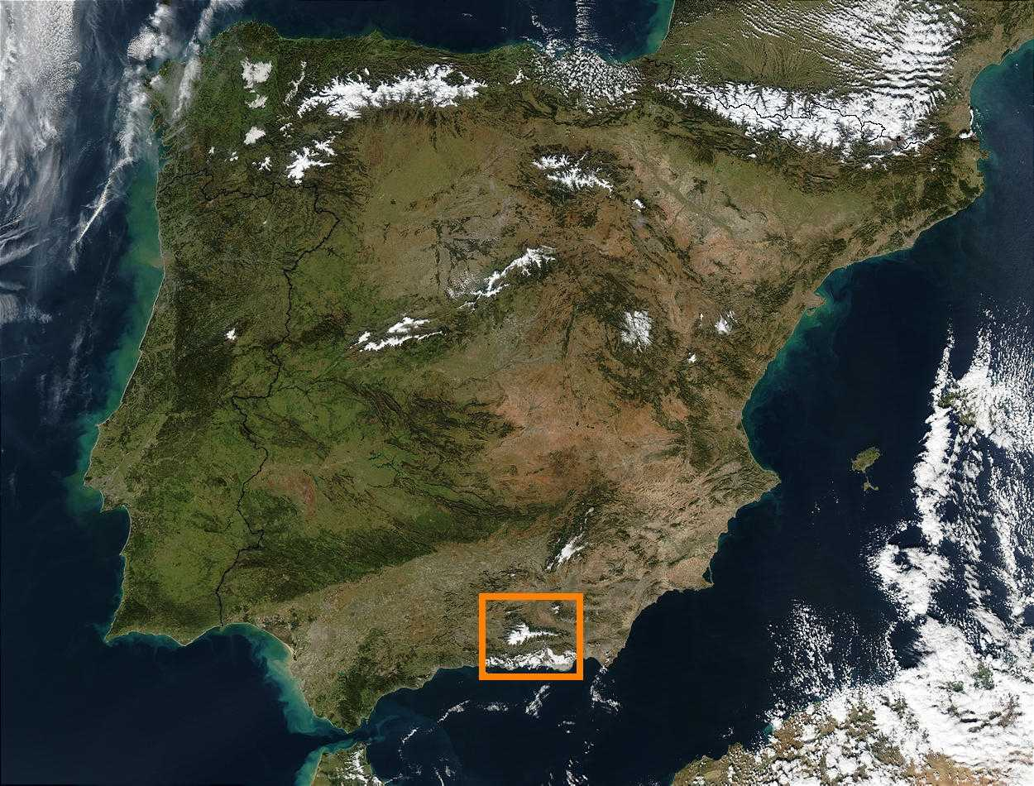
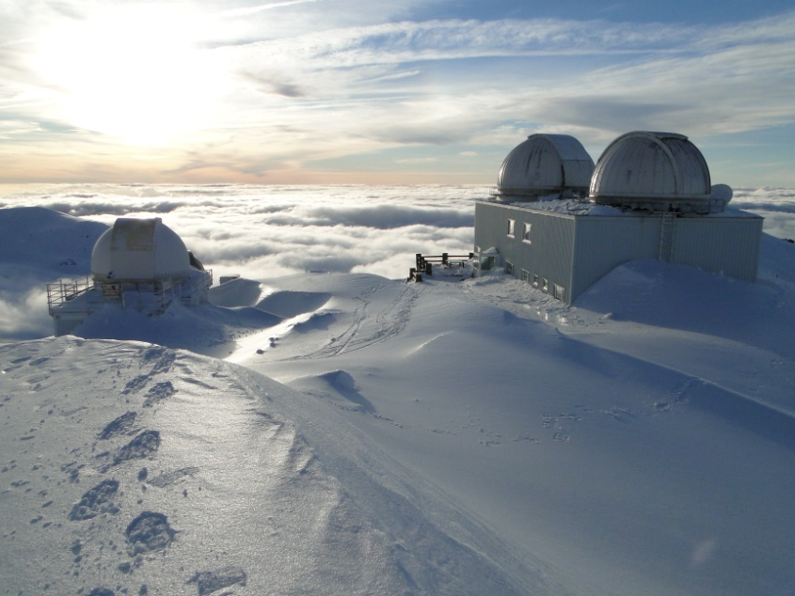
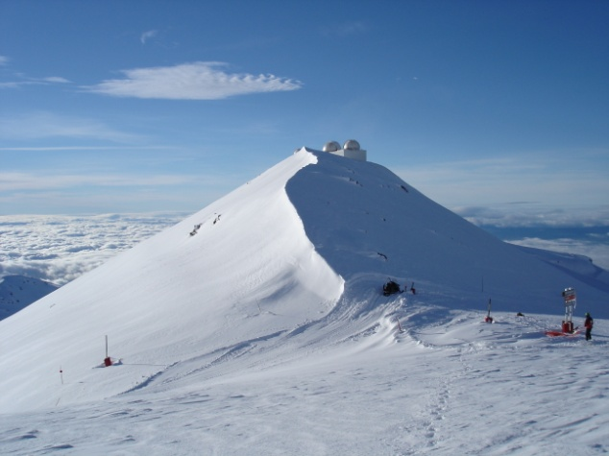
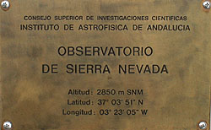
Located at Loma de Dilar in the Sierra Nevada mountain range (Granada)
Altitude: 2900 m above sea level
100% Spanish (IAA- CSIC)
Notes:
The Sierra Nevada Observatory is located at Loma de Dilar in the Sierra Nevada mountain range in Granada

Slide 3
Telescopes
Main building: Nasmyth telescopes T150 (1.5m) and T90 (90cm)
T150: a low resolution spectrograph (Albireo) and a CCD camera with a FoV of 8’ x 8’
T90: six channel photoelectric photometer (Strömgren photometer) and a CCD camera with a FoV of 17’x 17’
Other installations (projects):
T60: robotic telescope with a IR camera (BOOTES-IR project)
T35: 14’’ telescope with a wide field CCD camera (variable
stars)
SATI: interferometer (dynamic of the high layers of the
Earth atmosphere)
Spectrometer (study of the sky at infrared and sub-mm
wavelengths)

Slide 4
Observing modes
For T150 and T90 telescopes
- Service
- In-situ
- Remote
Very important: the telescopes can not be operated in service mode at the same time!
Why?.
The personnel is reduced: 3 night assistants (1 assistant/night)

Slide 5
The OSN is a modest observatory
In favour...
Long term observations
Photometric multisite campaigns, studies of comets,
catalogues of stars, surveys, etc.
Outreach activities (guide visits in summer)
To get started in the use of telescopes
But against...
Difficult access during the winter
Lack of technical personnel with plain dedication
The OSN has no assigned budget.
Notes:
Ski resort, snowmobile. The mid-station Borreguiles, which is served by two cable cars that run from the bottom of Pradollano, is at 2675 m. Here there are a few cafés and restaurants, a ski schools, a few hire shops and lockers.

Slide 6
Future?...
Notes:
The Sierra Nevada Observatory is located at Loma de Dilar in the Sierra Nevada mountain range in Granada

