Slide 1
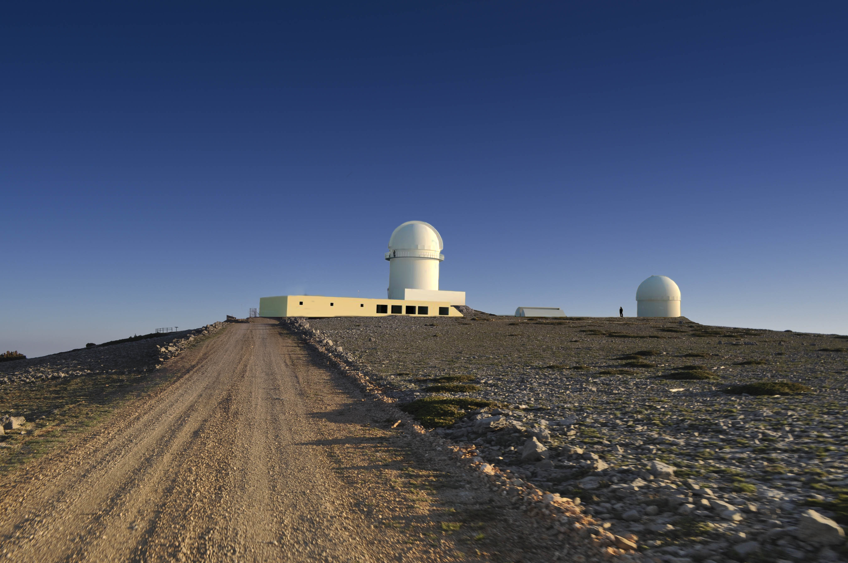


OBSERVATORIO ASTROFÍSICO DE JAVALAMBRE
TELESCOPES & FIRST LIGHT INSTRUMENTATION
MANAGEMENT OF THE OAJ CONTRACT
Javier Cenarro
CEFCA
Ramón y Cajal Fellow

Slide 2
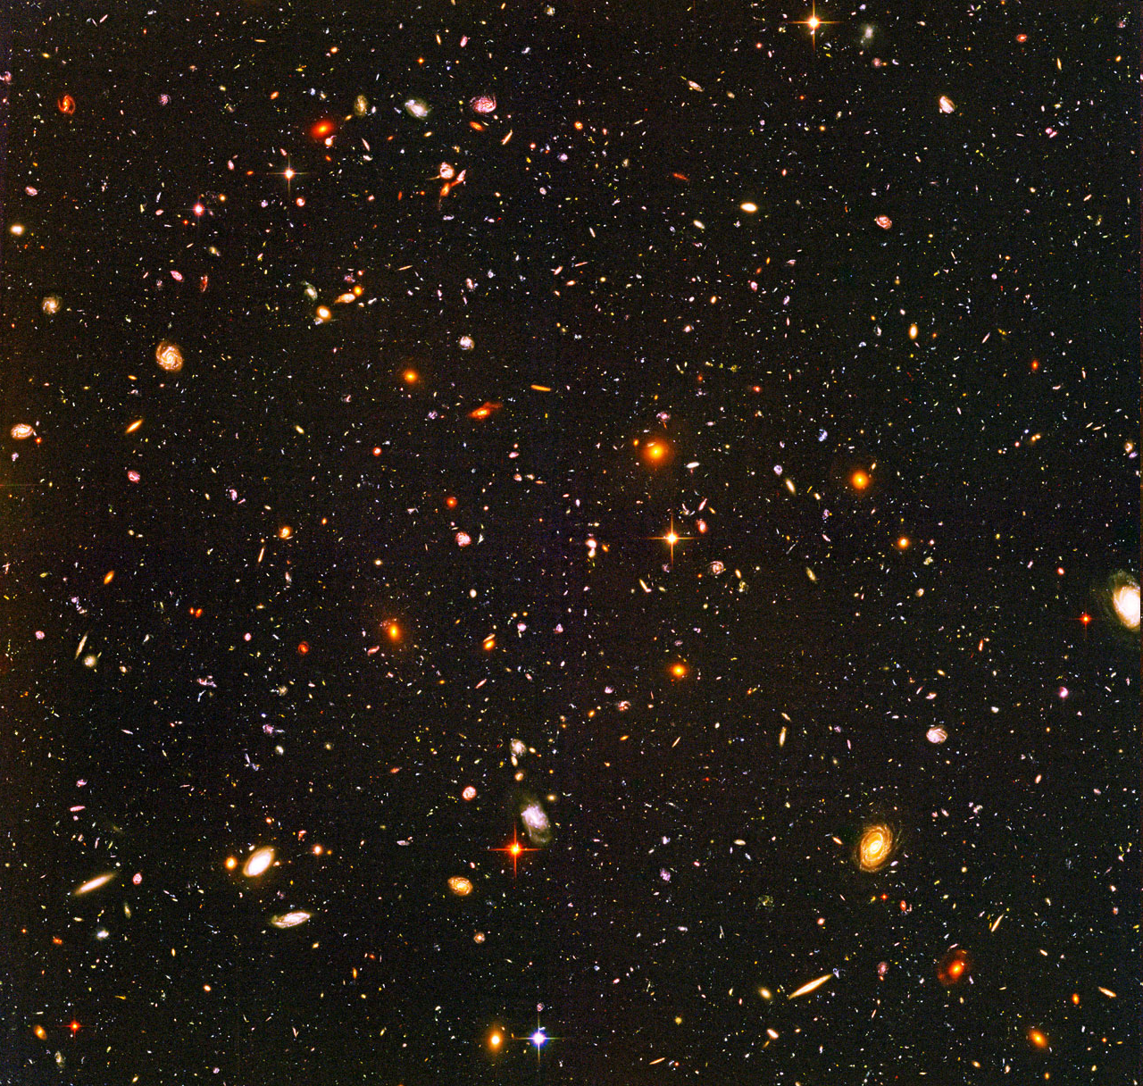
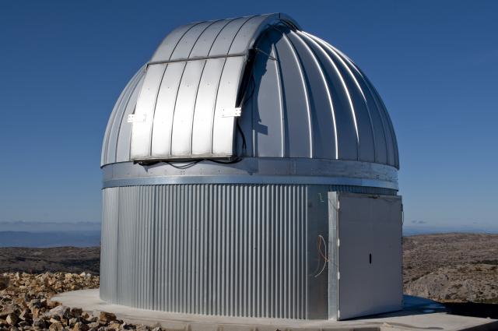
THE OBSERVATORIO ASTROFÍSICO DE JAVALAMBRE (OAJ):
A NEW OBSERVATORY FOR CARRYING OUT LARGE SKY SURVEYS
Large Etendue (A x Ω) Telescopes
Good image quality all over the entire FoV → Field Correctors
Effective Etendue (A x Ω x t)
JST/T250 (2.55m; FoV 3 deg)
J-PAS: ~4-5 years since 2014
JAST/T80 (0.83m; FoV 2 deg)
J-PLUS: ~2 years since 2013
≥ 30% open time

Slide 3
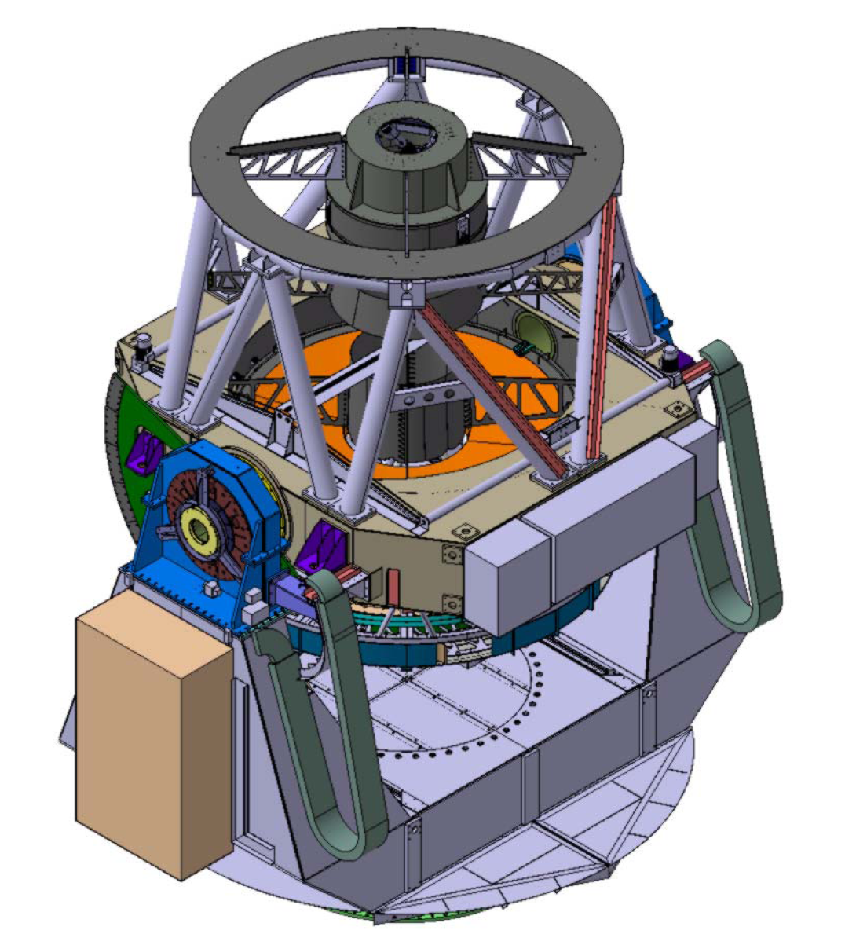
JST/T250
M1 (∅) = 2.55 m
FoV (∅) = 3 deg = 476 mm at FP
Effective collecting area = 3.89 m²
Etendue = 27.5 m²deg²
Plate scale = 22.67 arcsec/mm
= 0.22 arcsec/pix
Focal length = 9098mm → F#3.5
IQ EE50 (∅) < 12μm = 0.27 arcsec
IQ EE80 (∅) < 20μm = 0.45 arcsec
Mount = Alt-azimuthal
Config. = Ritchey Chrétien-like
Focus = Cassegrain
Field corrector of 3 lenses
Mass ~45.000 kg
1st Eigenfrequencies > 10 Hz
Manufacturer: AMOS (Belgium)
Current Status: AIV – Integration
On site by Fall 2012
Notes:
Before the arrival of the 8.1m LSST (319m2 deg2 ) in 2018, it will be the largest etendue telescope (Pann-STARRS – PS1: 13m2 deg2 ; SDSS, with good image quality in just the central degree: 3.14m2 deg2 ; SkyMapper: 5.2m2 deg2 ; VST: 4.52m2 deg2 ; VISTA (NIR): 6.8 m2 deg2 ; CFHT: 9.32m2 deg2 ). The 4m Blanco Telescope, with the DES Camera will reach 38.16m2 deg2 , but only 30% of the time will be devoted to the survey.

Slide 4
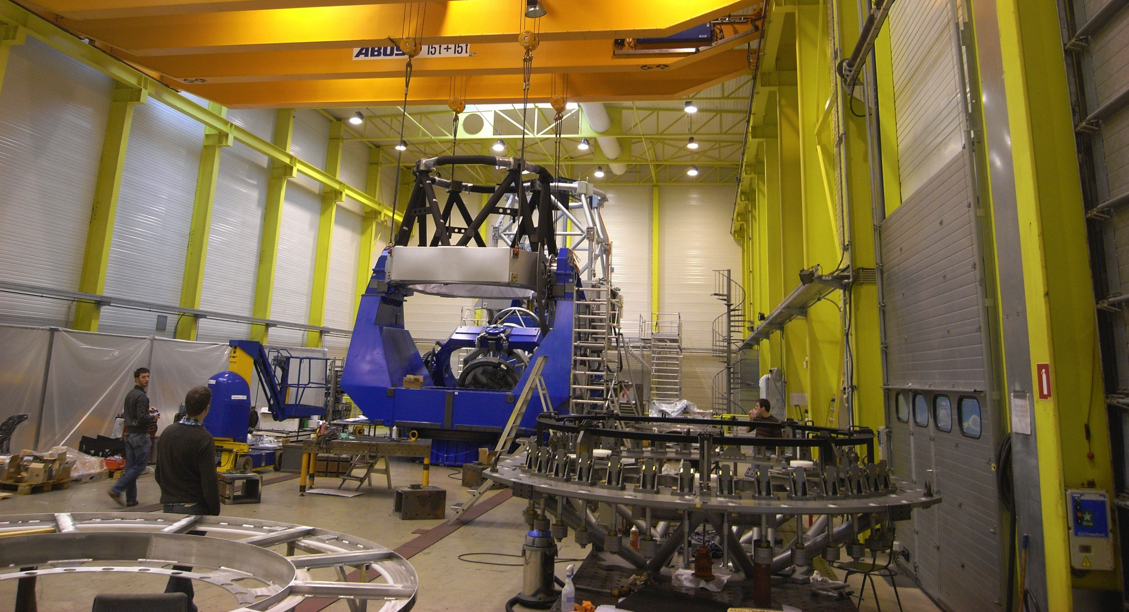
JST/T250

Slide 5
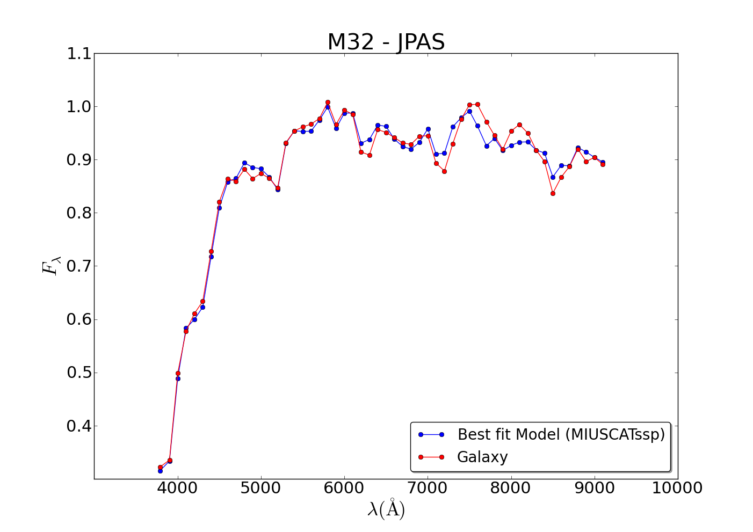
J-PAS
~8000 deg² with 54 (+2) filters of ~100Å width down to AB~23 – Time: ~ 5 years
Barionic Acoustic Oscillations
Photo-z’s (Δz~0.3%) for tens of millions of LRGs, ELGs and QSOs.
Plus many other scientific returns:
Galaxy evolution, SFR evolution, galaxy clusters, 2D stellar populations, Milky Way structure, SNe, GRBs, very low mass objects, exoplanets, Solar System minor bodies…
Notes:
Sloan: 54seg integration per filter; 0.4”/pix

Slide 6
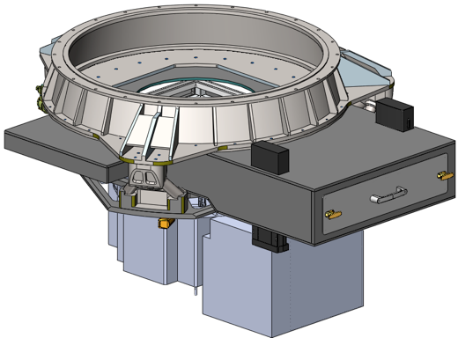
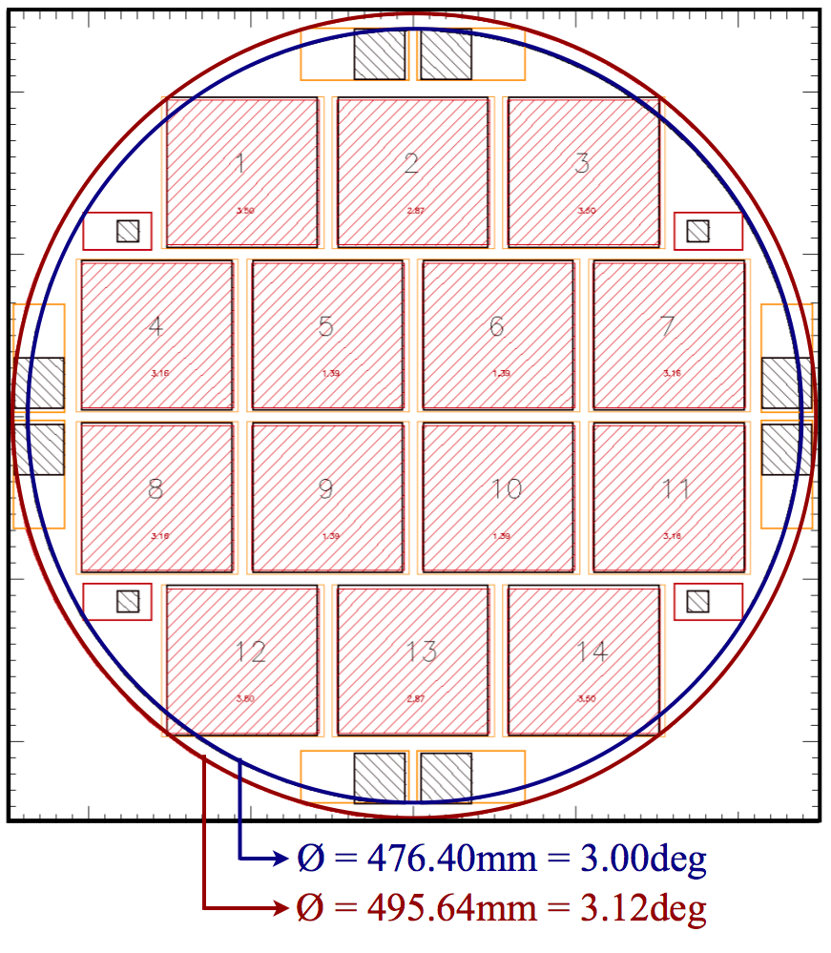
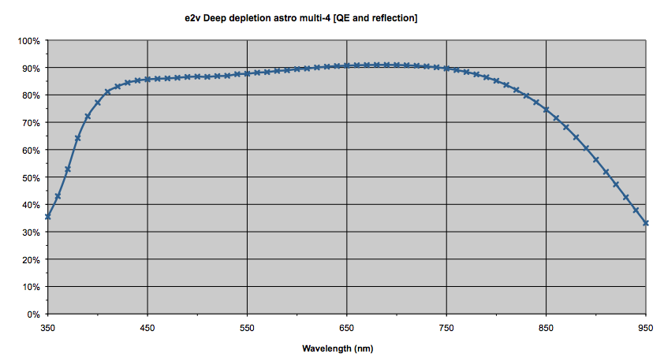
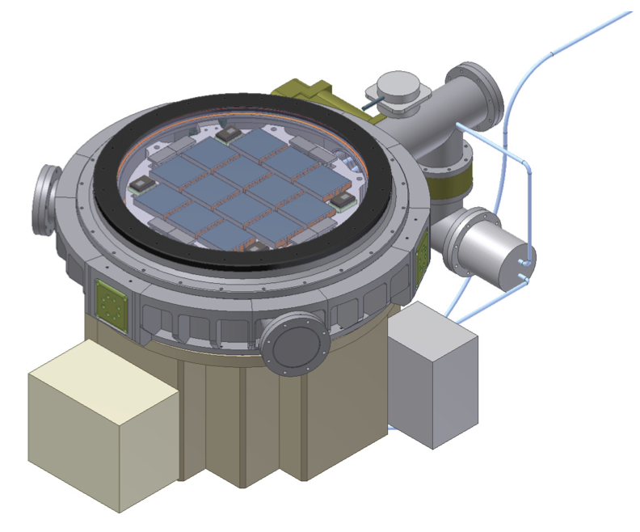
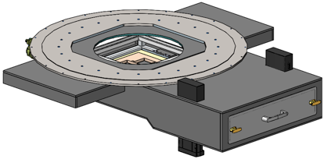
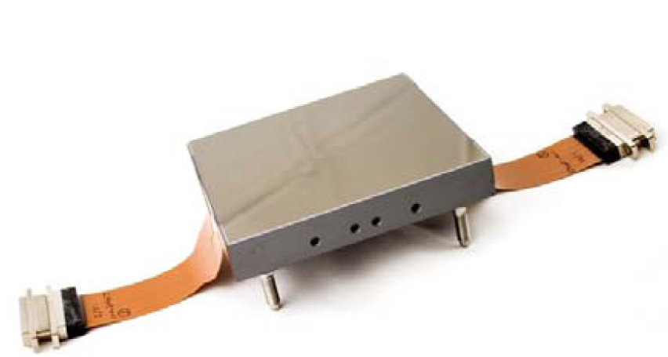
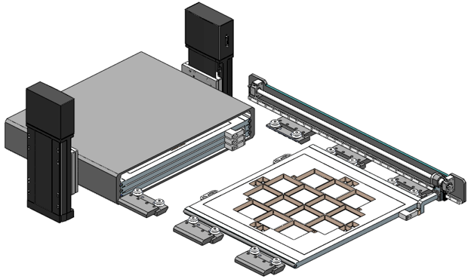
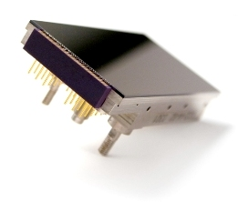
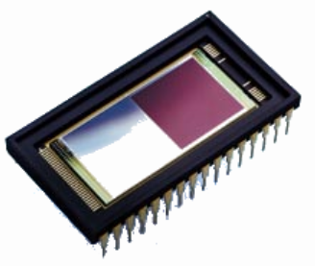
JPCam
FoV | Ø=3.0º (full performance) Ø = 3.1º (reduced performance)
CCD format | 9216 x 9240 pix, 10 µm/pix
Pixel scale | 0.22 “/pix
Read out time | 12s
Read out noise | 6 e⁻/pixel
camera unit
filter/shutter unit

Slide 7
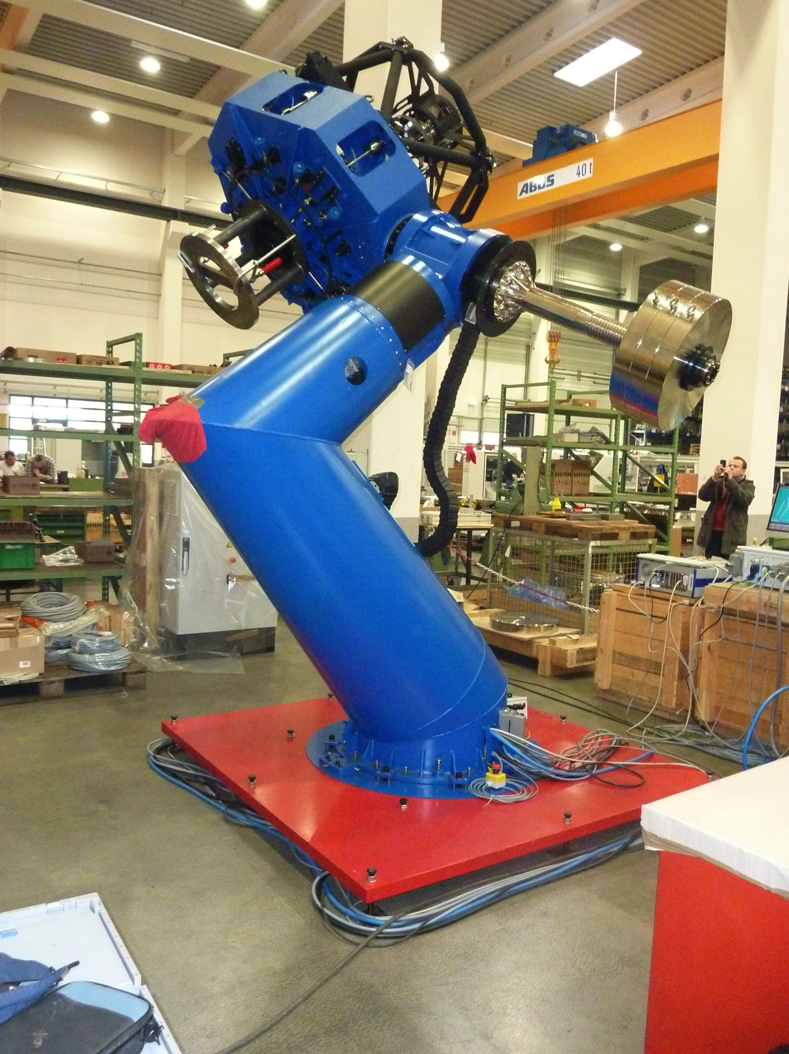
JAST/T80
M1 (∅) = 0.83 m
FoV (∅) = 2 deg = 130 mm at FP
Effective collecting area = 0.44 m²
Etendue = 1.5 m²deg²
Plate scale = 55.56 arcsec/mm
= 0.50 arcsec/pix
Focal length = 3712mm → F#4.5
IQ EE50 (∅) < 7μm = 0.39 arcsec
IQ EE80 (∅) < 14.5μm = 0.81 arcsec
Mount = German equatorial
Config. = Ritchey Chrétien
Focus = Cassegrain
Field corrector of 3 lenses
Mass 2.500 kg
1st Eigenfrequencies > 10 Hz
Manufacturer: ASTELCO (Germany)
Current Status: AIV - Verification
On site by Spring 2012

Slide 8
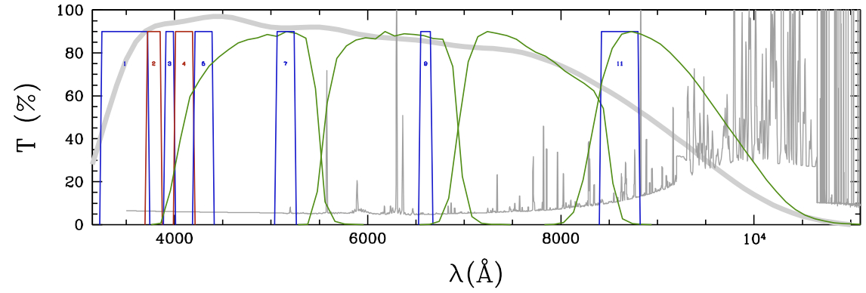
J-PLUS
Based on lessons learned from Bailer-Jones (2000, 2004), Bessell (2005), Jordi et al. (2006), etc
“Stellar physical parameters can be recovered with a combination of 10-15 medium and broad band filters with S/Ns ~50”
SDSS (g, r, i, z) + u_{J} + J378_[OII] + J395_[H+K] + J410_[Hδ] + J430_[G-band] +
J515_[Mgb-Fe] + J655_[Hα] + J861_[CaT]
T80Cam STA CCD 10.5k x 10.5k 0.5”/pix → FoV = 2.12 deg²
>1000 calibrating stars per pointing with AB < 18 and S/N > 50 at the North Galactic pole
In ~1800s integration time “on target” (u_{J}, g, r, i > 23; others > 22; S/N > 5)
8000 deg² in 2-2.5 years, starting in Spring 2013
Notes:
Sloan: 54seg integration per filter; 0.4”/pix

Slide 9
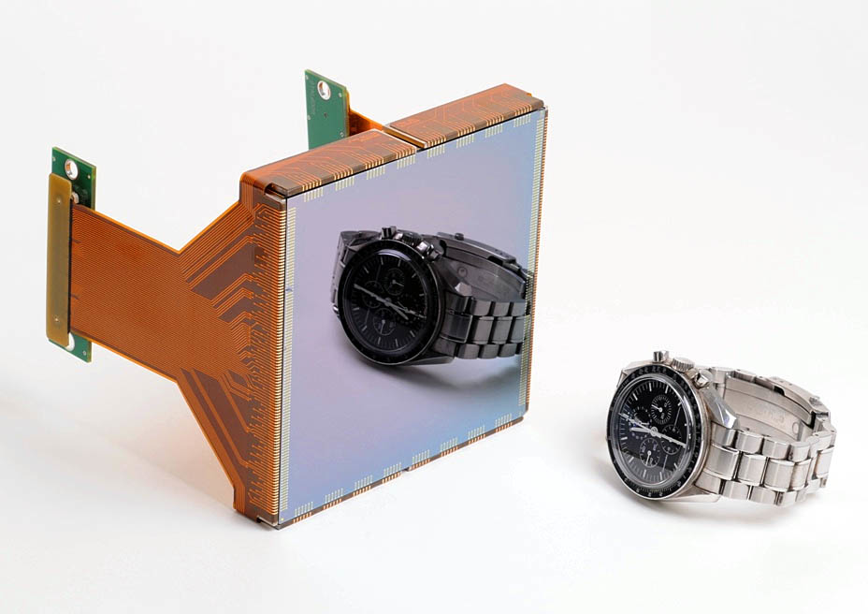
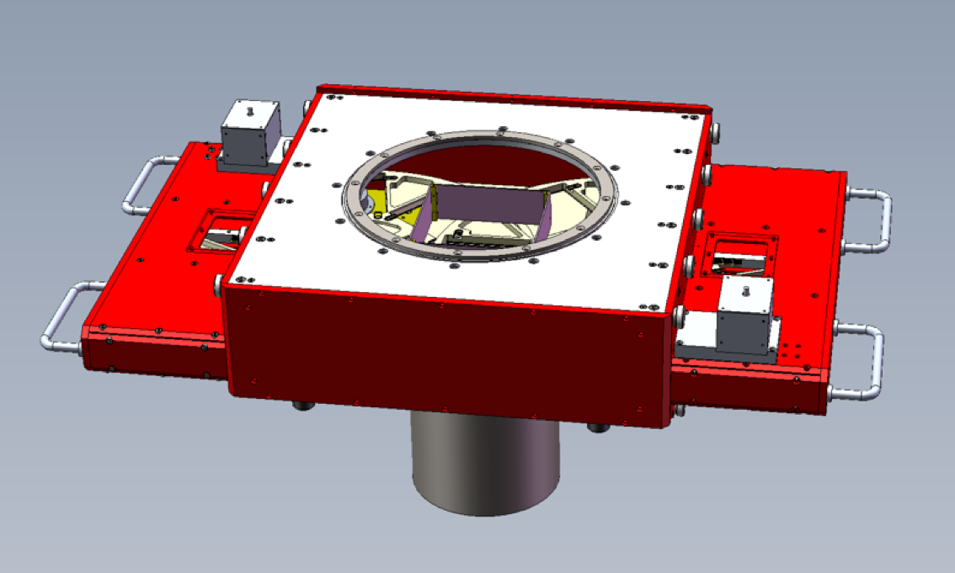
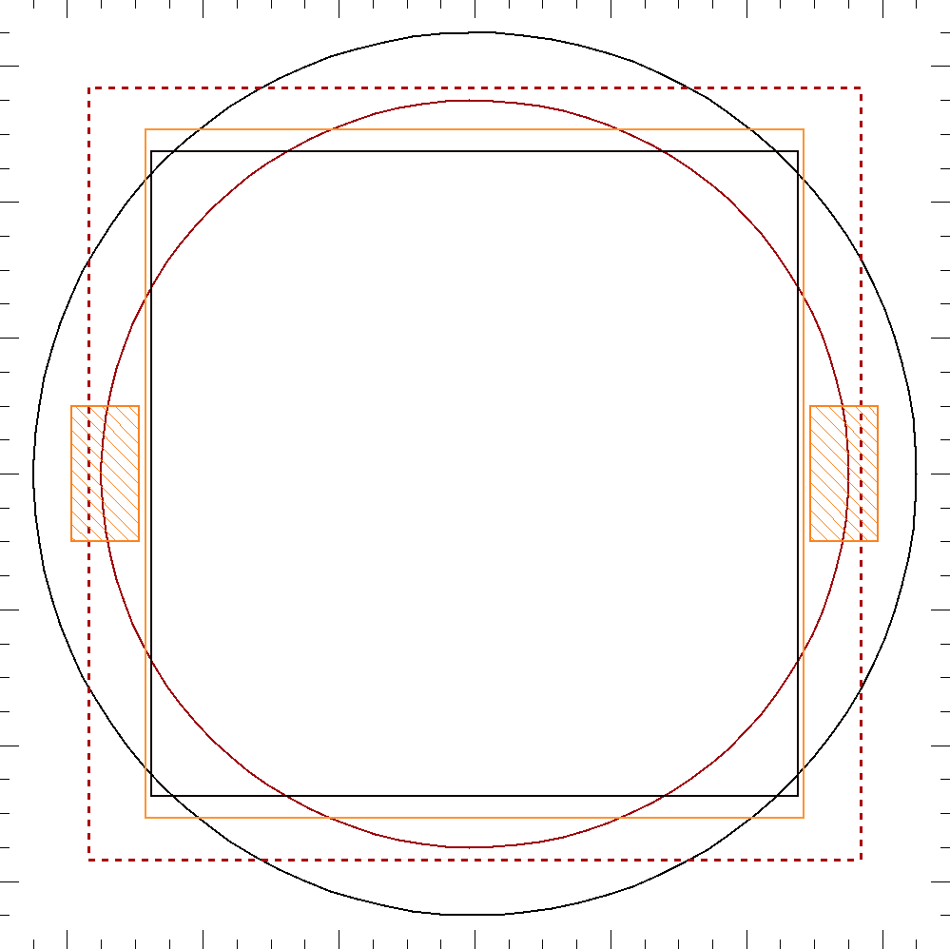
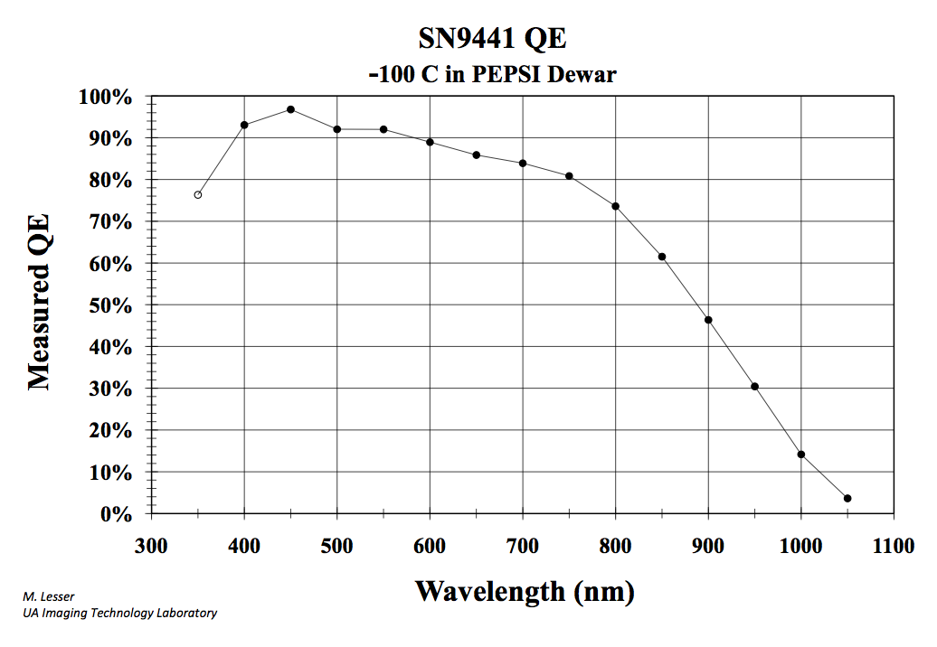
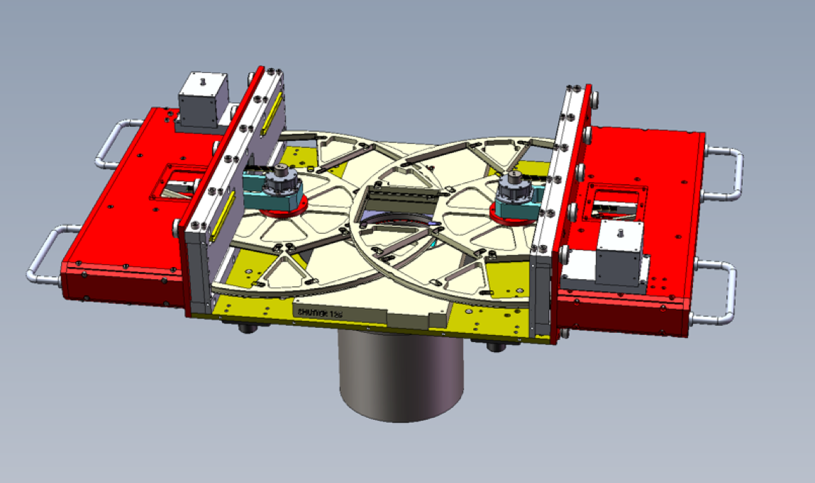
T80Cam
∅1.7º
95.05 mm
∅2º
95.22 mm
STA CCD
10Kx10K, 9μm/pix
FoV | Ø=1.7º (full performance) Ø = 2.0º (reduced performance)
CCD format | 10580 x 10580 pix, 9 µm/pix
Pixel scale | 0.5 “/pix
Read out time | <20s
Read out noise | <6 e⁻/pixel

Slide 10
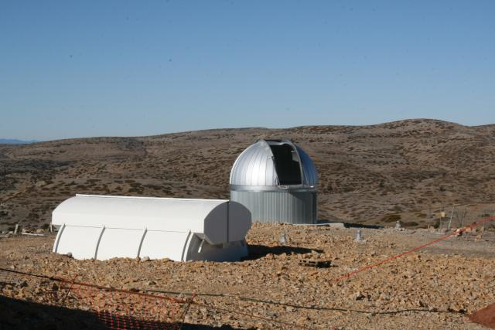
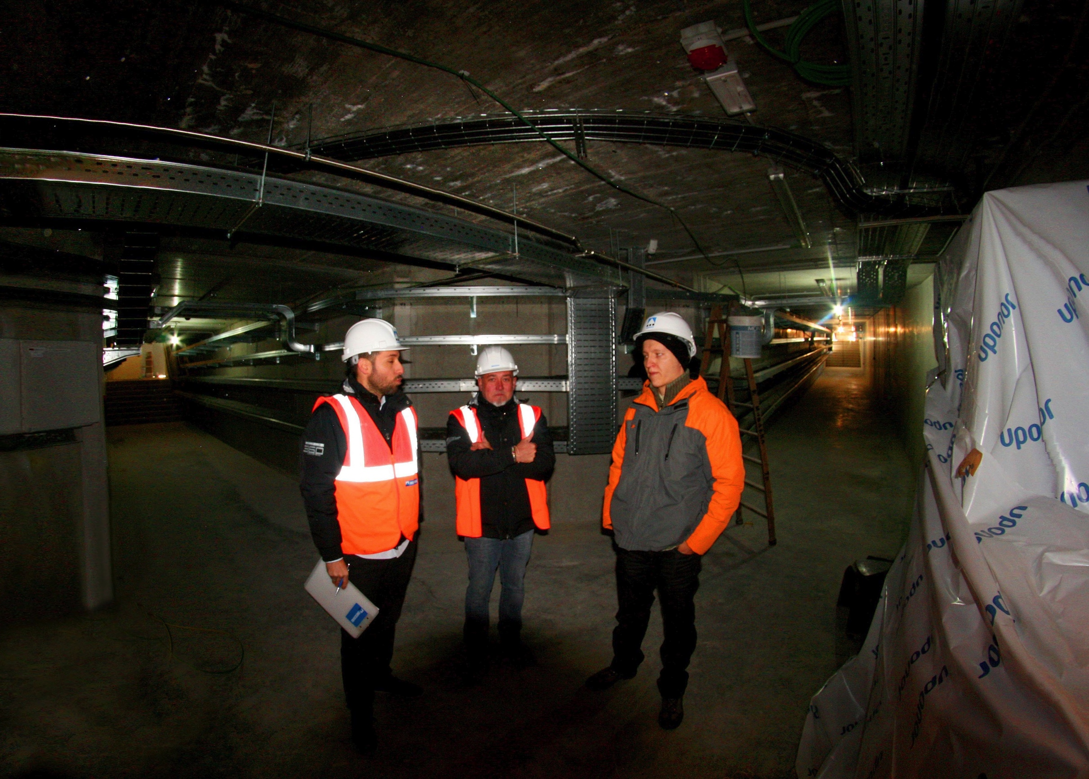
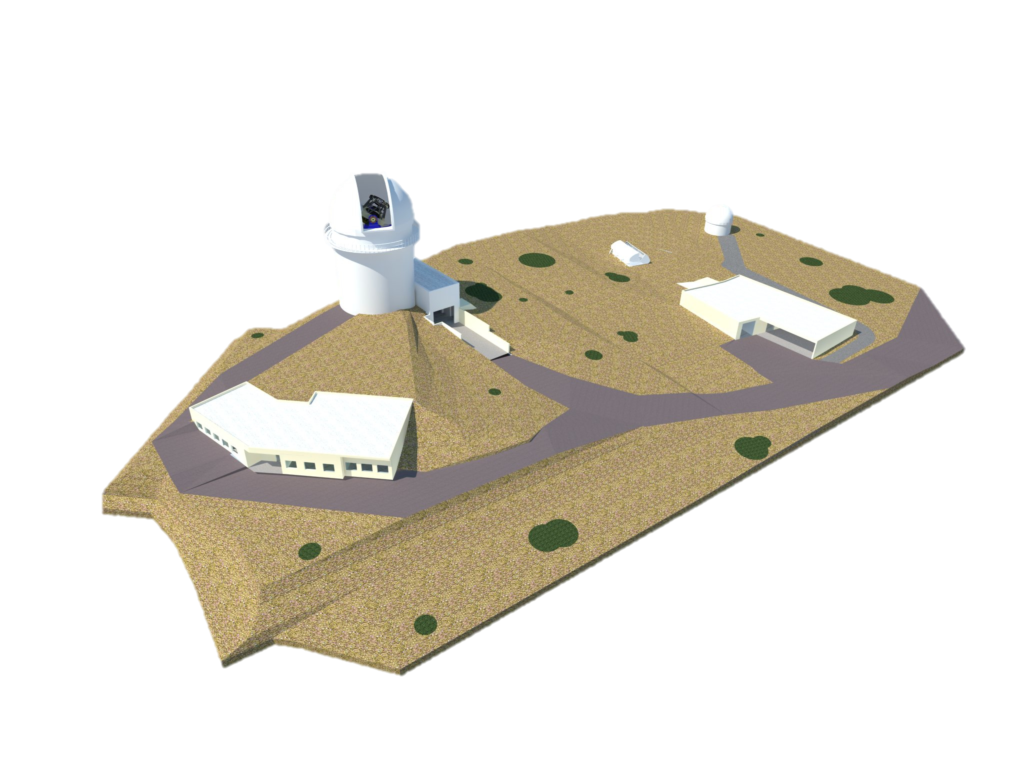
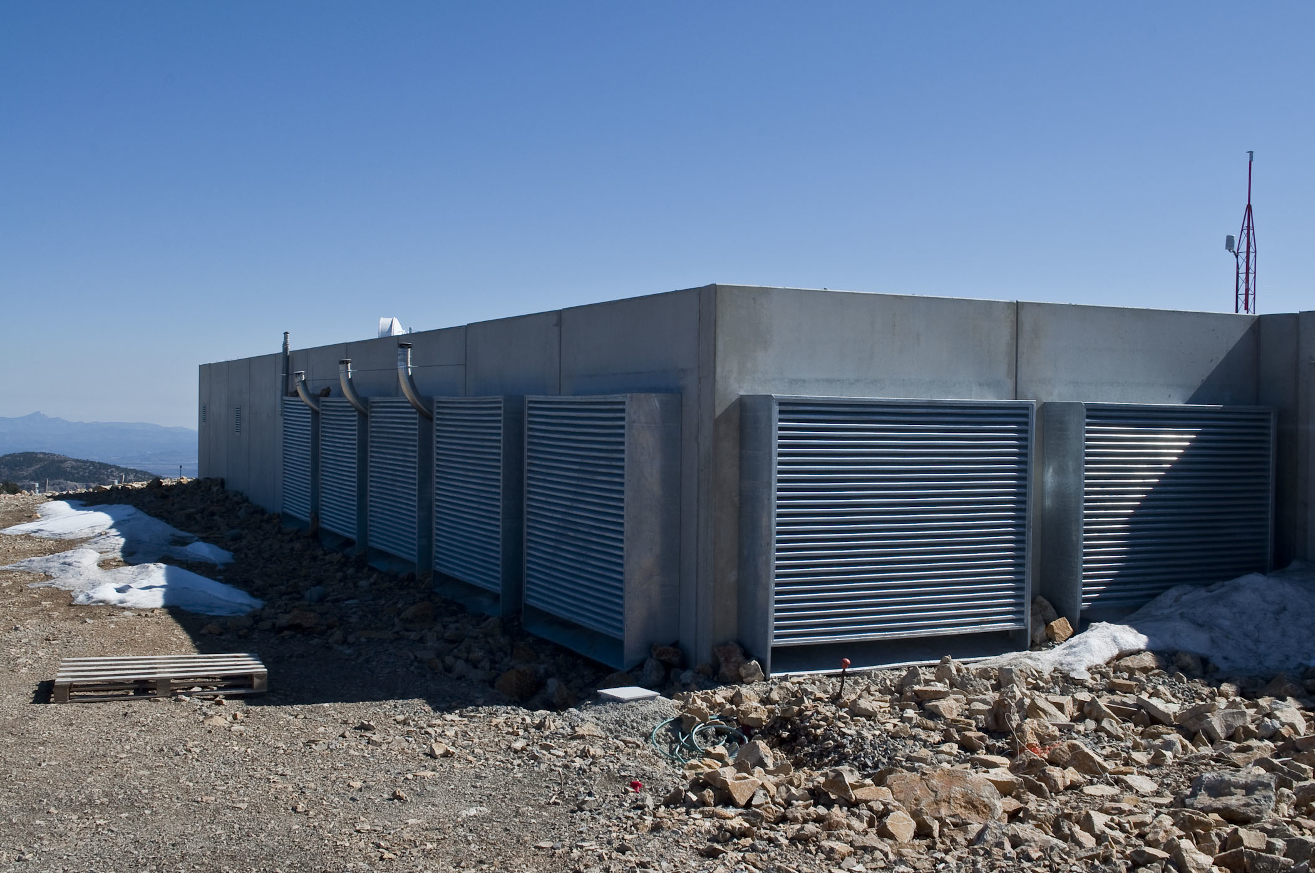
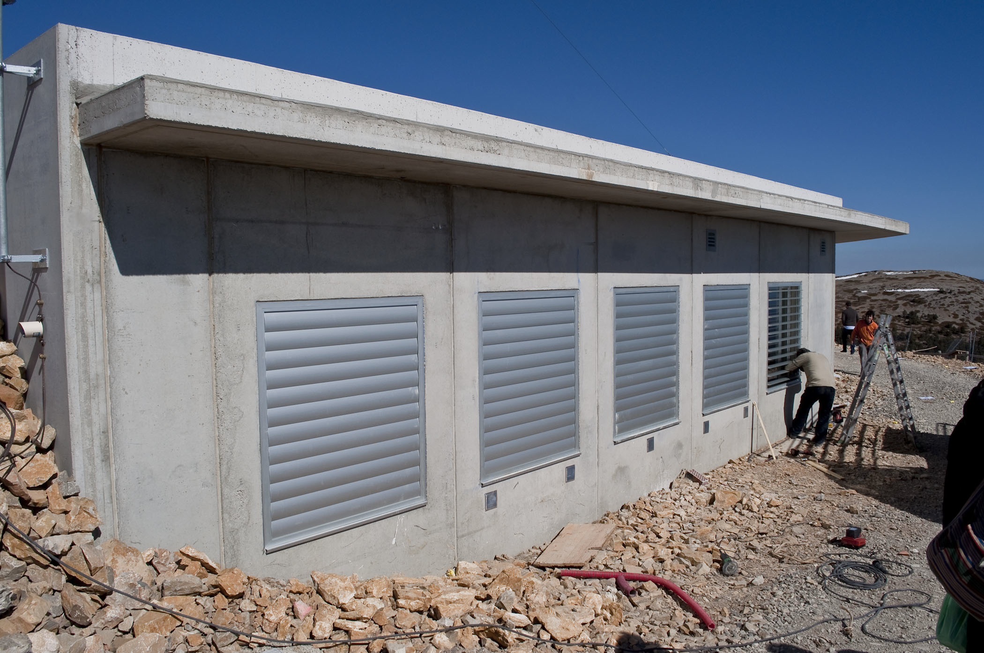
OAJ FINAL DESIGN
T250
Monitor
Building
T80
Coating
Plant
General Services
Plant
Residence
Control Room &
Laboratories

Slide 11
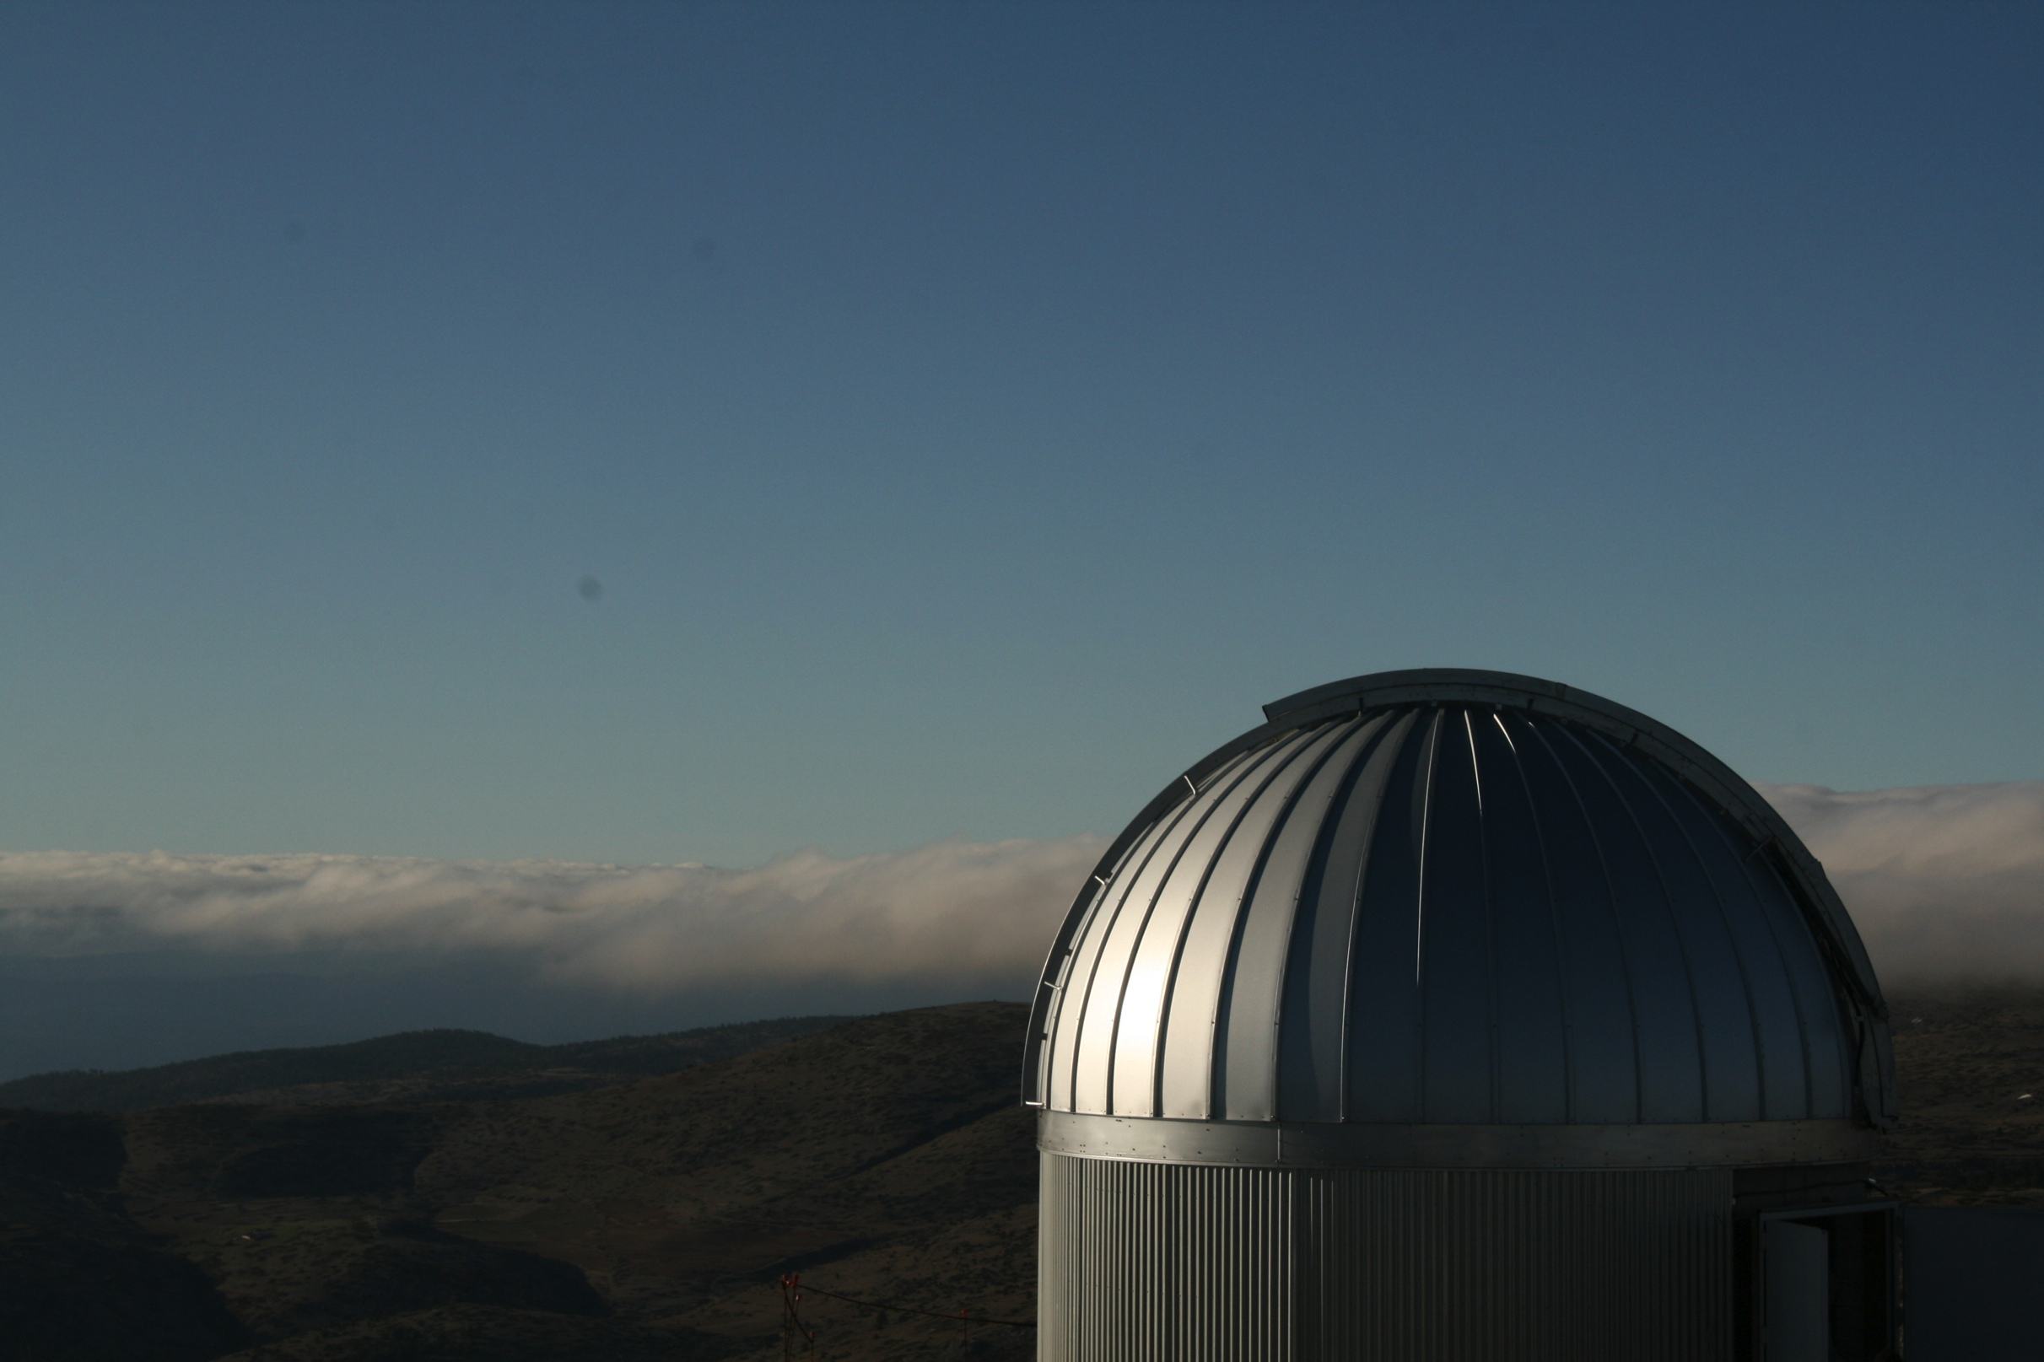
http://www.cefca.es
http://j-pas.org

Slide 12
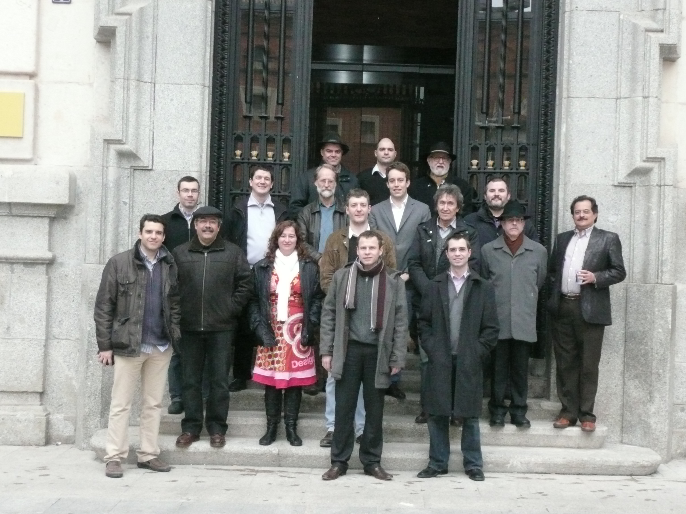
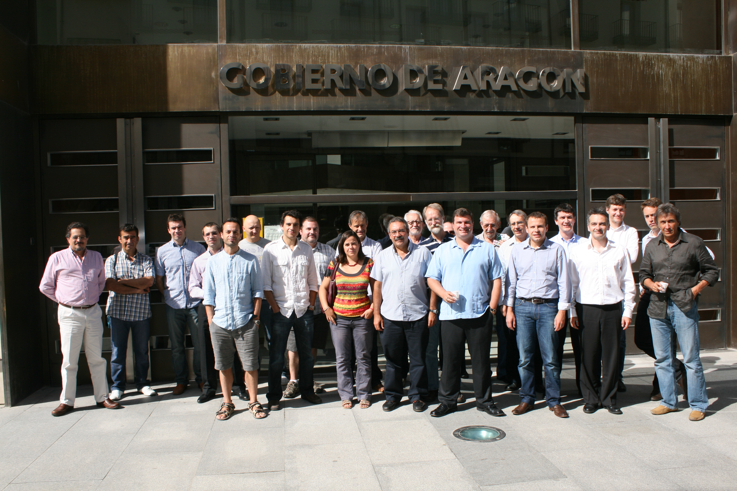
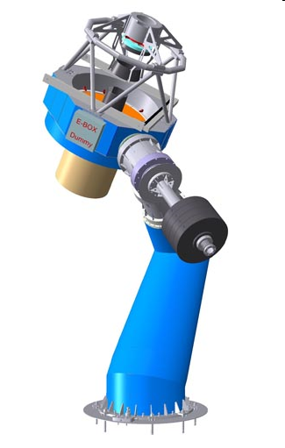

THE OAJ TELESCOPES
JST/T250
M1=2.55m
FoV=3º
Design: AMOS and CEFCA
Supervised by a international committee of experts (PDR + FDR)
JAST/T80
M1=0.83m
FoV=2º
Fabrication
T250: AMOS (Belgium)
T80: ASTELCO (Germany)
Main subcontractors: Tinsley (USA), Brashear (USA), Schott (Germany), Symétrie (France), PI (Germany), OSL (UK), etc.
Notes:
Mass 45000 kg – Low carbon steel plates and tubes – First eigenfrequencies > 10 Hz.
Dome ∅ 9.5m

