Slide 1
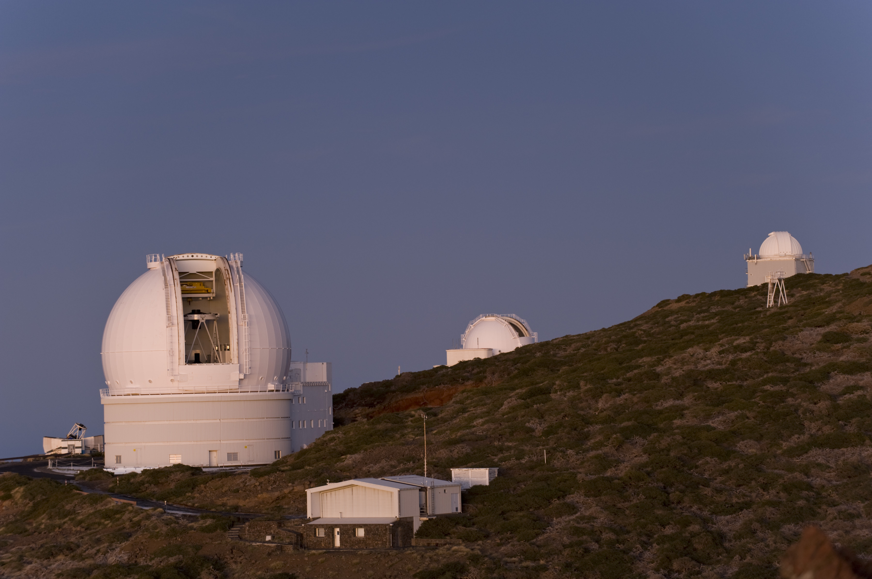
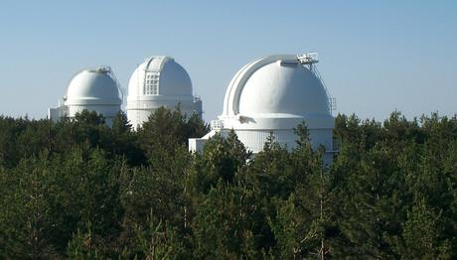
Science with the optical-infrared telescopes at CAHA and ORM in the coming decade
CDTI, Madrid, 2012 March 22-23

Slide 2
Gracias …
SOC de esta reunión por apoyar la propuesta
RIA por aprobar y financiar la propuesta
Pilar Román, CDTI por su interés en tener a los astrónomos aquí
A ESTHER CALLE POR SU PACIENCIA CON NOSOTROS

Slide 3
Welcome
Mid-size telescopes (2-4 m) are going through redefinition of their role
Multi-faceted process
    Funding Agencies…
    Telescope directors…
    Expert panels… (eg ETSRC 2010)
    National, international priorities

Slide 4
We need to hear from …
YOU
Telescopes to continue only if users say/show they need them
Direct input from users on instrument priorities, modes of operation

Slide 5
Instrumentation
What current instruments are most useful for your science
Is new instrumentation needed
  Wide field vs high spatial resolution
  Spectroscopy? Imaging?
  Optical vs NIR
  High vs mid spectral resolution

Slide 6
Classical observing vs survey work
Now
  WHT largely classical observing
  CAHA 3.5m half-surveys
Case for increasing the fraction of time devoted to surveys
Case for retaining visitor mode

Slide 7
Exotic modes – drop them to save €€?
Polarimetry
UV imaging, spectroscopy
High time resolution
High spatial resolution. Adaptive optics
  Lucky imaging
  Speckle

Slide 8
Northern sky access – an opportunity?
Much glass in Spain!
Spain as leader of northern hemisphere astronomy in Europe
    Just how important is the northern sky to you?

Slide 9
Data
Role of observatories in providing
    Data reduction pipelines
    Fully reduced data
    User-friendly archives

Slide 10
Training needs
Role of observatories in training next generation of astronomers

Slide 11
We are here to hear …
YOUR views
As derived from your plans/aspirations
Previous ING workshop with this topic
    2010 March, London
Today, centered on Spanish astronomy
    Together with CAHA

Slide 12
Sessions
Infrastructure Summaries
Science themes
New instruments
Large programmes
Observatory operations, time assignment
Discussion

Slide 13
Science with the optical-infrared telescopes at CAHA and ORM in the coming decade
Discussion Panel

Slide 14
Topics
Instrumentation
Observing modes
  data handling
Actions

Slide 15
Instrumentation
What do we want/need
  What are we ready to give up
  CHOICES ← PRIORITIES
Note: you are astronomers, don’t do the strategic planning, focus on what you need to carry out your science
    And what priorities you are ready to set

Slide 16
Optical MOS
WEAVE
HEXA
Spain’s contribution to WEAVE’s instrument specification
Interest in starting up with AF2 – ‘son of weave’

Slide 17
Other instruments
High resolution spectrographs
    On 2m – 4m – 10m ?
Imagers
    Wide-field? High-spatial resolution?
    Optical? NIR?
    Depth?
Exotic modes?
    Polarimetry; speckle; lucky

Slide 18
Observing modes
Do you need long programmes
    Can you stand long programmes
  Astronomer’s input on implementation
Results mode

Slide 19
Data handling
Pipelines
    Impact on observing modes
Impact on training

Slide 20
Actions
Request a national strategy

