Slide 1
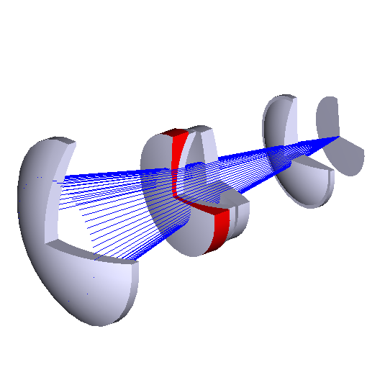
2-degree WHT PF optical correctors
Tibor Agócs
2010-03-23

Slide 2
Purpose of the talk
Wide-field spectroscopy/imaging is the driver
  MOS
  IFU
  NB/WB imager
Current FOV is 40 arcmin – it’s not enough
How do we increase the WHT FOV?
It’s possible to design reasonable systems that satisfy the requirements up to 2 degrees
Notes:
Yesterday there were talks about wide field spectroscopy. There can be deviations in instrument specification, but whatever instrument we are putting at the top-end of the WHT, there will be always a need for a corrector between the primary and the instrument. I would like to show two PFC designs for the WHT, which can satisfy the requirements.

Slide 3
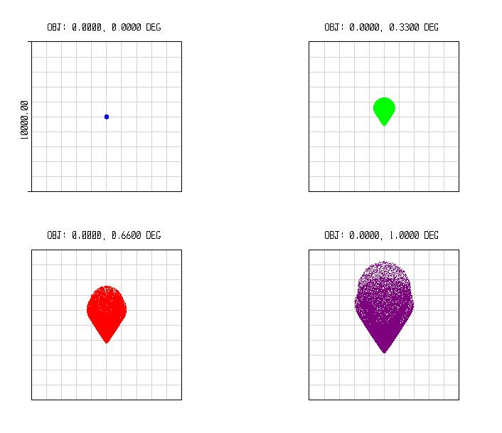
Problems to consider
Spot diagram for WHT prime focus at 500nm.
Box size is 190 arcsec !
190 arcsec

Slide 4
Problems to consider
Reasonable design for 2 degrees
box size is 5 arcsec!
0 degrees zenith angle
60 degrees zenith angle
5 arcsec

Slide 5
Options for increasing the FOV
Modify current PFC
  Keep mechanics
  Design new optics
  Interface optics with the existing environment
New PFC
  Similar design
  Larger components
Forwarded-Cassegrain
  New secondary
  New Cassegrain focal station

Slide 6
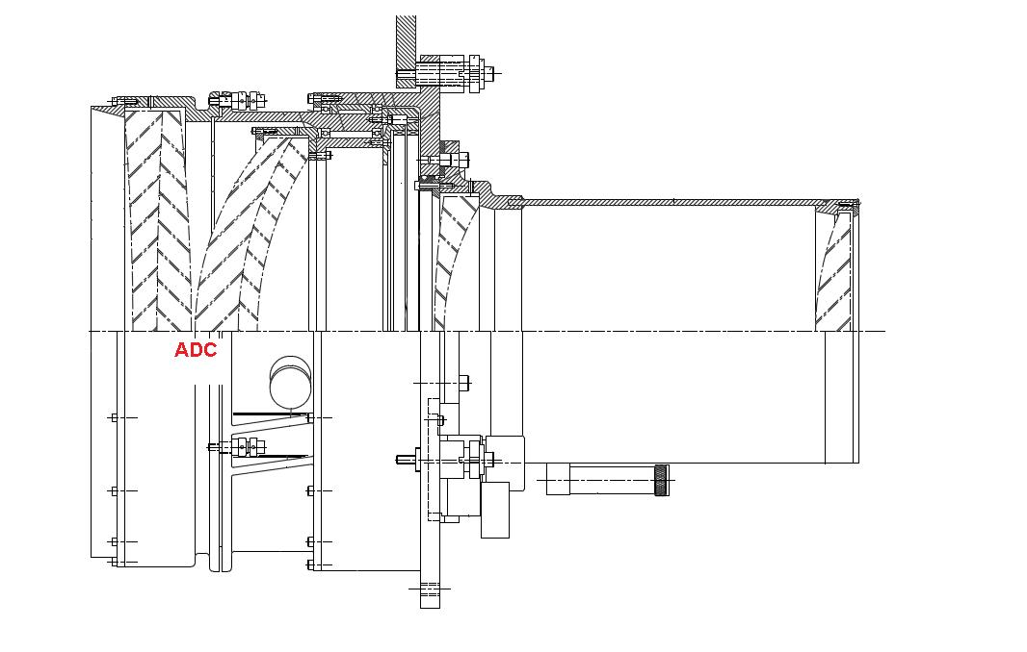
Current PF corrector
Light from
Primary
Instrument platform

Slide 7
Considerations for the new PFC design
Correctors’ power usually is close to zero
Expected F/number is 2.5-2.8 (it is not controlled, it could float within these limits)
It gives a reasonable plate scale, which is between 52-59 microns/arcsec
2-degree field on the CCD: 380mm-420mm (F2.5-F2.8)
Notes:
From now I’m talking about the new PF version

Slide 8
Considerations for the new PFC design
Many new PF correctors contain Fused Silica only
  More economical
  Excellent throughput
BUT, since SPECTROSCOPY is the driving force behind the PFC design, the polychromatic imaging performance has to be good for the PFC
  ADC is needed
  Different lens materials are needed for the ADC
  Multi glass design could be expected
Available glasses
Design steps
Cost, schedules

Slide 9
2-degree designs
Specification
  Optimization for spectroscopy (explore imaging too)
  Max. zenith angle for optimization : 65 degrees
  Throughput
  Polychromatic image quality
    shouldn’t decrease the best seeing
    < 0.5 arcsec
    some degradation is acceptable at the edge of field
  Wavelength range
    330nm – 1000nm or 380nm-1000nm
Other requirements...
Notes:
Careful – there will be talks about this on the 1st day
May need change...

Slide 10
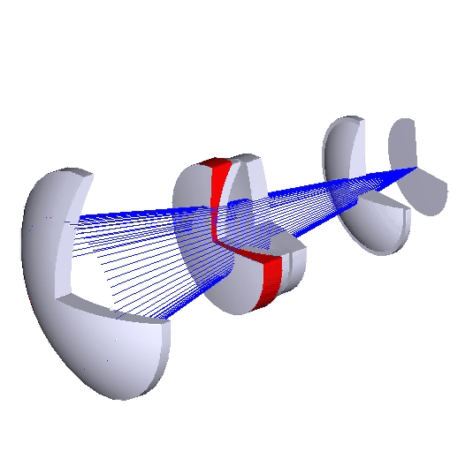
2-degree designs
  TRADC - Traditional counter- rotating
  ADC
Notes:
It contains a counter rotating ADC, which is basically two doublets placed in the beam. Each of them introducing dispersion but these dispersions are cancelling out each other, when the telescope is at zenith. When the telescope is moving at elevation, they are counter-rotated and the introduced dispersions are not cancelling out each other anymore, they are added together step by step.

Slide 11
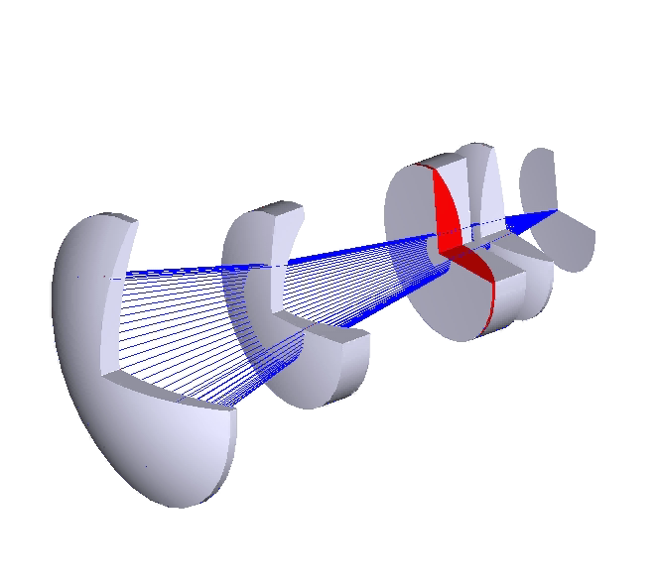

2-degree designs
  SUBARU - Subaru type ADC, it has to be decentred and tilted

Slide 12
ee80 comparison
380nm-1000nm
y axis – ee80 diameter in arcsec
TRADC
0.5 arcsec
FIELD POINTS – perpendicular to elevation direction
x axis – field radius in deg
Notes:
X axis – field radius in degrees
Y axis – diameter of the circle, which contains the 80% of the energy of the beam in arc seconds
(the 80% of the energy is within a 0.5 arcsec diameter circle)

Slide 13
ee80 comparison
380nm-1000nm
y axis – ee80 diameter in arcsec
TRADC
0.5 arcsec
FIELD POINTS – parallel with elevation direction
x axis – field radius in deg

Slide 14
ee80 comparison
380nm-1000nm
y axis – ee80 diameter in arcsec
SUBARU
0.5 arcsec
FIELD POINTS – perpendicular to elevation direction
x axis – field radius in deg

Slide 15
ee80 comparison
380nm-1000nm
y axis – ee80 diameter in arcsec
SUBARU
0.5 arcsec
FIELD POINTS – parallel with elevation direction
x axis – field radius in deg
Notes:
Asymmetrical due to the ADC lens, which is shifting out from the beam...

Slide 16
ee80 comparison V band
500nm-600nm
y axis – ee80 diameter in arcsec
TRADC vs. SUBARU
0.5 arcsec
FIELD POINTS – perpendicular to elevation direction
x axis – field radius in deg

Slide 17
ee80 comparison R band
600nm-730nm
y axis – ee80 diameter in arcsec
TRADC vs. SUBARU
0.5 arcsec
FIELD POINTS – perpendicular to elevation direction
x axis – field radius in deg

Slide 18
y axis – throughput
Throughput
330nm-1000nm
TRADC vs. SUBARU
Without primary mirror
x axis – wavelength (um)
360nm
1000nm

Slide 19
y axis – throughput
Throughput
330nm-400nm
TRADC vs. SUBARU
Without primary mirror
x axis – wavelength (um)
360nm

Slide 20
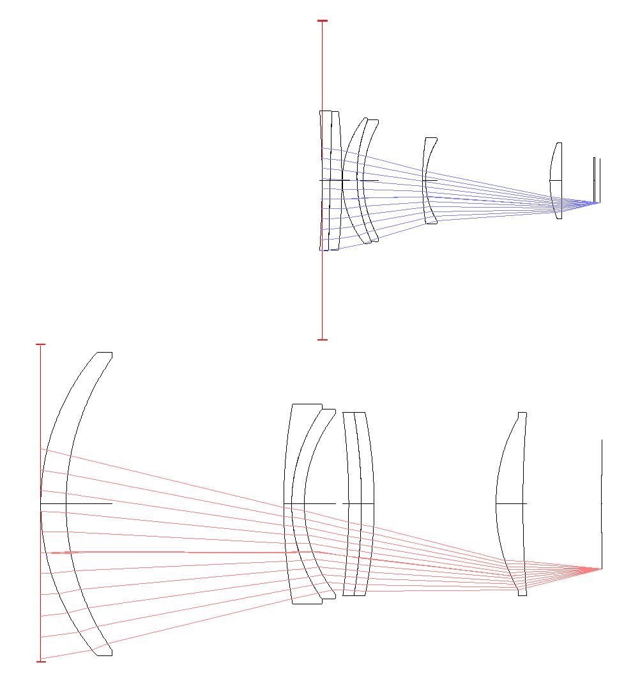
Scales
current optics
vs.
2-degree design
Scale bar – 1m

Slide 21
Conclusions
We can increase the FOV at the WHT prime focus
  It’s possible to design systems, which satisfy the requirements
  2-degree FOV is possible, 380nm – 1000nm is possible
  Can the FOV be larger? Yes, to increase FOV 0.5 degrees, 2x price
  Can we extend it more to the UV? Yes, 2x price
These designs are feasible
  They take into account requirements like
    Availability of materials
    Manufacturability
    Coupling to the instrument
    Cost

Slide 23
Contents
Purpose of the talk
Problems to consider
Current design
Options for increasing the FOV
Considerations for a new PF design
Conclusion
Notes:
Basically I started to work on the design of the PFC in last August, and since I followed the
Purpose of the talk - The current corrector has a 40 minutes field, we are aiming 2 deg. How do we get this 2 deg?
Problems to consider – field aberrations, dispersion
Current design – what we have
Options – Prime focus vs. Fwd Cass (David King)
Considerations for the new design – spec, requirements, design steps, performance

Slide 24
Current PF corrector
Vignetting
  40 arcmin un-vignetted FOV
  At 1 degree 60% un-vignetted rays
F-number and plate scale
  F/2.81
  57micron/arcsec (17.55arcsec/mm)
Lenses
  Counter -rotating zero deviation ADC
  Two more lenses
Space envelope
  640mm x 750mm
  Weight is approx 650kg
Notes:
Let’s see how the current corrector looks like!

Slide 25
Considerations for the new design
Design steps:
  Design without ADC
    Basic designs: Wynne’s 4 lens design, Faulde & Wilson 3 lens design...
  Try different degrees of freedom
    Curved image surface
    Different materials
    Aspherical surfaces
  Include ADC
    Transform one or two elements into ADC
    Rescale the Bingham design
    Wang & Su designs
  Re-optimize – Hammer optimization

Slide 26
Considerations for the new design
Large lenses
Which are the available glasses?
  Schott: N-BK7 (UBK7), Fused Silica, N-FK5, LLF1, F2, LF5 and SF6
  Ohara: above 500mm only Fused Silica
  Corning: Fused Silica
Schedules?
  1 meter N-BK7 blank (!) – 1 year
  Certain large elements are rarely manufactured – N-FK5 is once in every 2 years approx.
Prices:
  1 meter Fused Silica with so called slumping technique – 300k EUR

Slide 27
Considerations for the new PFC design
Similar designs
  4m class
    2dF
    Blanco PFC (DES)
    Discovery Channel telescope PFC
  8-10m class
    Subaru MegaPrime / Hyperprime
Notes:
Surveys (cosmology):
Imaging: DES, Euclid,
Spectroscopy: SDDS, 2dF, BigBOSS,
Others:
Imaging: UKIDSS, PAN-STARRS, MegaCam / HyperCam, SkyMapper, VST, Vista, CTIO 4m DE
All sky: 2MASS, UCAC3
LAMOST (Chinese)
GAIA (Space)

Slide 28
2-degree designs
Other requirements
  Special materials
    UBK7 material should not be used because it increases costs and manufacturing time significantly
  Aspherical surfaces
    Maximum Aspheric Deviation (MAD) from the best fit sphere
    Maximum steepness of the surface
  Fibres
    Standard fibre NA=0.22, which corresponds to 25.4 degrees acceptance cone angle
    Higher cone angle is possible too but throughput will be affected

Slide 29
2 degree designs
spot diagrams – box size 1 arcsec
TRADC
SUBARU

Slide 30
ee80 comparison B band
390nm-500nm
y axis – ee80 diameter in arcsec
TRADC vs. SUBARU
0.5 arcsec
FIELD POINTS – perpendicular to elevation direction
x axis – field radius in deg

Slide 31
ee80 comparison I band
730nm-900nm
y axis – ee80 diameter in arcsec
TRADC vs
SUBARU
FIELD POINTS – perpendicular to elevation direction
x axis – field radius in deg

Slide 32
Pros and cons for the TRADC and SUBARU designs
TRADC
  Pros
    Well known design
    Slightly better image quality and throughput
    Smaller input cone angles for the fibres
  Cons
    Aspherical surface is more difficult to manufacture/test
    More difficult to align
SUBARU
  Pros
    Aspherical surface is easier to manufacture/test
    Easier to align
  Cons
    New design
    Slightly worse image quality and throughput
    Larger input cone angles for the fibres

Slide 33
Other important optical design issues
Fibres
Imaging
Modelling filters
Athermalization
  Especially if different materials are used
  Refocusing as compensation
Ghosts analysis
  Important for correctors
Scattered light analysis
FEA analysis
AR coating
  Probably only single layer for the largest lens
Optical bonding
  CTE
  Refraction indices
  Durability
Tolerancing
Careful specification
  Homogeneity, stress birefringence are key issues
  Test methods – extremely important
Alignment plan

